Slide 1
ESD Assessment & Certification with
AISHE
Niko Roorda, PhD
Avans University, Netherlands
nroorda@planet.nl
Notes:
1

Slide 2






Definitions (1): Definition of Assessment
European Foundation
for Quality Management
’Excellence model’
for Quality Management
in Industry
Dutch Institute
For Quality Management
’5 stages model’
for Quality Management
in Industry
European Foundation
for Quality Management
‘Excellence model’
for Quality Management
in Industry
European Foundation
for Quality Management
‘Excellence model’
for Quality Management
in Industry
Expert Group of
Dutch Universities
‘Method for HE’
for Quality Management
in Higher Education
Dutch National
Foundation for
Sustainable Higher Ed.
‘AISHE’
for Sust. Development
in Higher Education
European Foundation
for Quality Management
‘Excellence model’
for Quality Management
in Industry
European Foundation
for Quality Management
‘Excellence model’
for Quality Management
in Industry
Notes:
2

Slide 3
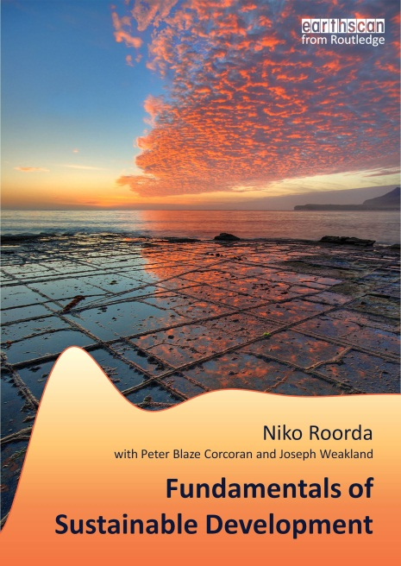
Definitions (2):
Definition of
Sustainable
Development:
Based on
SD Textbook
(Roorda et al, 2012)

Slide 4


Definitions (3): Definition of ESD (Education for SD)
Interdisciplinary cooperation
Disciplinary integration
Multidisciplinary relations
Basics: introduction to SD
Input: Mission, goals
Output: Contributions to profession & Society

Slide 5
(Re)development of Education:
Priority
++
++
–
+
–
+
++
+
Tree model:
Roots: Vision, mission, education goals
Trunk: Basic module / introduction of SD
Biochemistry: Education methodologies
Branches: Disciplinary integration
Internal structure: Multidisciplinary integration
Forest, ecosystem: Interdisciplinary cooperation
Growth process: Development & maintenance of
study program
Fruits: Output: effect on professional field & society
Input
Process
Output

Slide 6
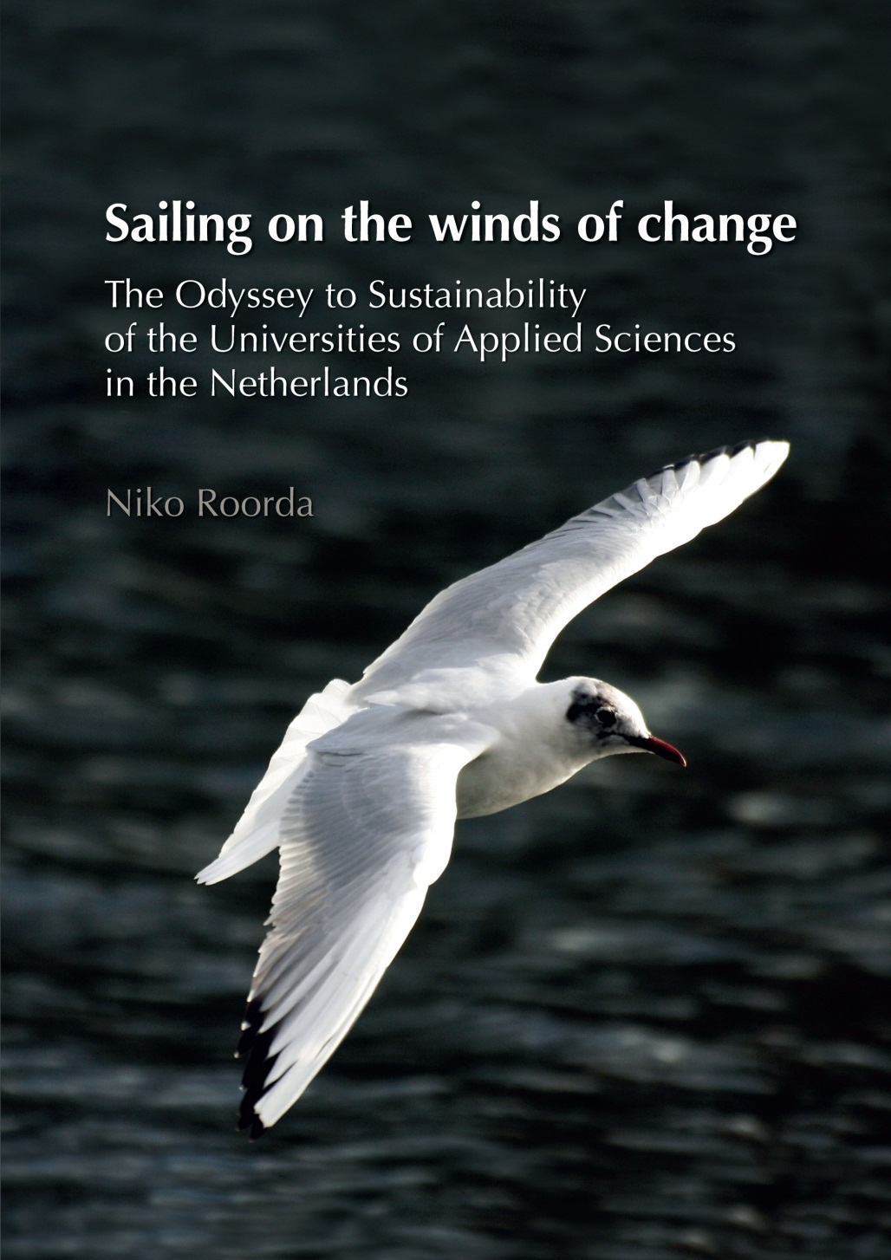
Definitions (4):
Definition of
SISD
(“System Integration
of Sustainable
Development”)
Based on
PhD Roorda (2010)
Chapter 7 & 10
Download as pdf from:
www.linkedin.com/in/NikoRoorda
→ ‘Files’ section

Slide 7
AISHE 1.0:
Developed and validated in 2000 -2001 (Netherlands, Sweden)
Applied ca. 300 – 400x
Applied in Netherlands, Belgium, Sweden, Germany, Finland, Austria, Spain, Ukrain, Lithuania, Bangladesh, Brazil
ESD Certificate: awarded ca. 100x
ESD Certificate is formally recognized by Dutch-Belgian
HE Accreditation Organization
Limitation: Focuses on education & organization

Slide 11
Stage 1: Ad hoc activities
Organisation development (EFQM, AISHE): 5 stages
Stage 5: Society
Stage 2: Process
Stage 3: System
Stage 4: Chain

Slide 12
E-1. Education Goals
The graduate profile determines the end goals of the education, i.e. the characterization of the professional who leaves the educational program and enters the professional field. Various terms are used for the graduate profile, e.g.: “educational program goals”; “professional profile”; ”academic qualifications”, “professional competencies”. etc.
Stage 1: Activity oriented | Stage 2: Process oriented | Stage 3: System oriented | Stage 4: Chain oriented | Stage 5: Society oriented
- The graduate profile contains some clearly recognizable aspects of SD. | - Within the own disciplinary context, the profile contains all or most relevant aspects of SD. | - The profile is explicitly based on the vision of the organization on SD. - Students are actively involved in the determination of the profile. | - The professional field is actively involved in the determination of the profile. | - Society is actively involved in the determination of the profile. Compared to similar institutions the organization fulfils a leading role with respect to the determination of the profile.
E-1. Education Goals
The graduate profile determines the end goals of the education, i.e. the characterization of the professional who leaves the educational program and enters the professional field. Various terms are used for the graduate profile, e.g.: “educational program goals”; “professional profile”; ”academic qualifications”, “professional competencies”. etc.
Stage 1: Activity oriented | Stage 2: Process oriented | Stage 3: System oriented | Stage 4: Chain oriented | Stage 5: Society oriented
- The graduate profile contains some clearly recognizable aspects of SD. | - Within the own disciplinary context, the profile contains all or most relevant aspects of SD. | - The profile is explicitly based on the vision of the organization on SD. - Students are actively involved in the determination of the profile. | - The professional field is actively involved in the determination of the profile. | - Society is actively involved in the determination of the profile. Compared to similar institutions the organization fulfils a leading role with respect to the determination of the profile.

Slide 13
ESD Certificate based on AISHE 1.0:
Certificate
Certificate

Slide 14
The assessment process
Participation by ca. 15 people:
1 or more managers
Ca. 6 professors / lecturers / teachers
Ca. 6 students
1 or more non-teaching staff
1 or more members of professional field
Time use: most of a day:
Introduction by assessor …….. 45 min.
Individual scoring by AISHE participants …….. 45 min.
Consensus meeting …….. 4 hours
Total …….. 5 - 6 hours

Slide 15
Part of an AISHE report:

Slide 16
The assessment results
A coherent report
Realistic knowledge about what you have at present
An SD Policy Plan for the coming year(s)
Managers, staff & students: support, enthusiasm, passion
If successful: the Certificate of SD in HE
(with 1 star, 2 stars, 3 stars …)

Slide 17
Certificate = SISD
“System Integration of Sustainable Development”
SISD not only refers to a systematic integration of sustainable development into an educational organization, but also, even primarily, at integration at a systems level.
This implies that SD has become a part of the fundamental nature of the organization, of its very identity.
If this is the case, sustainability has become a part of all or most activities, or at least of the thoughts and philosophies behind them.
Source: PhD dissertation, Roorda (2010), p. 138

Slide 18
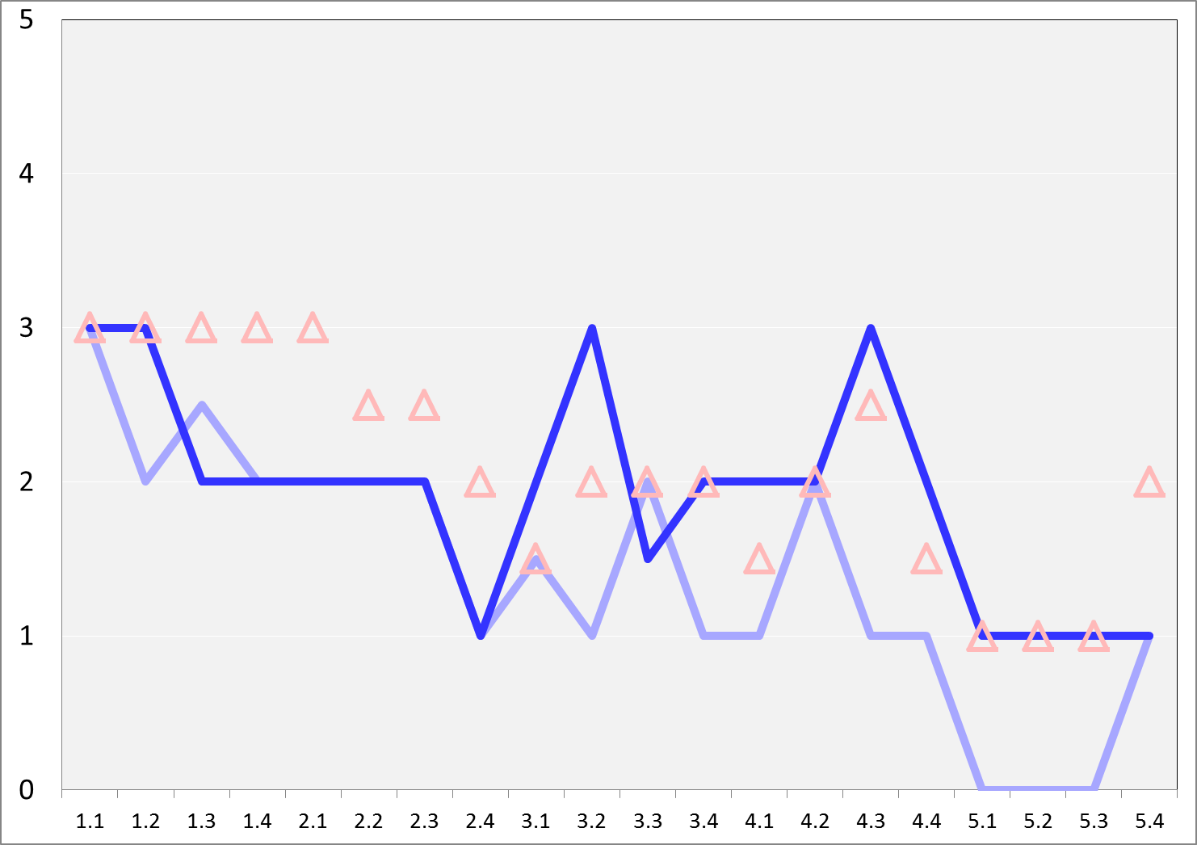
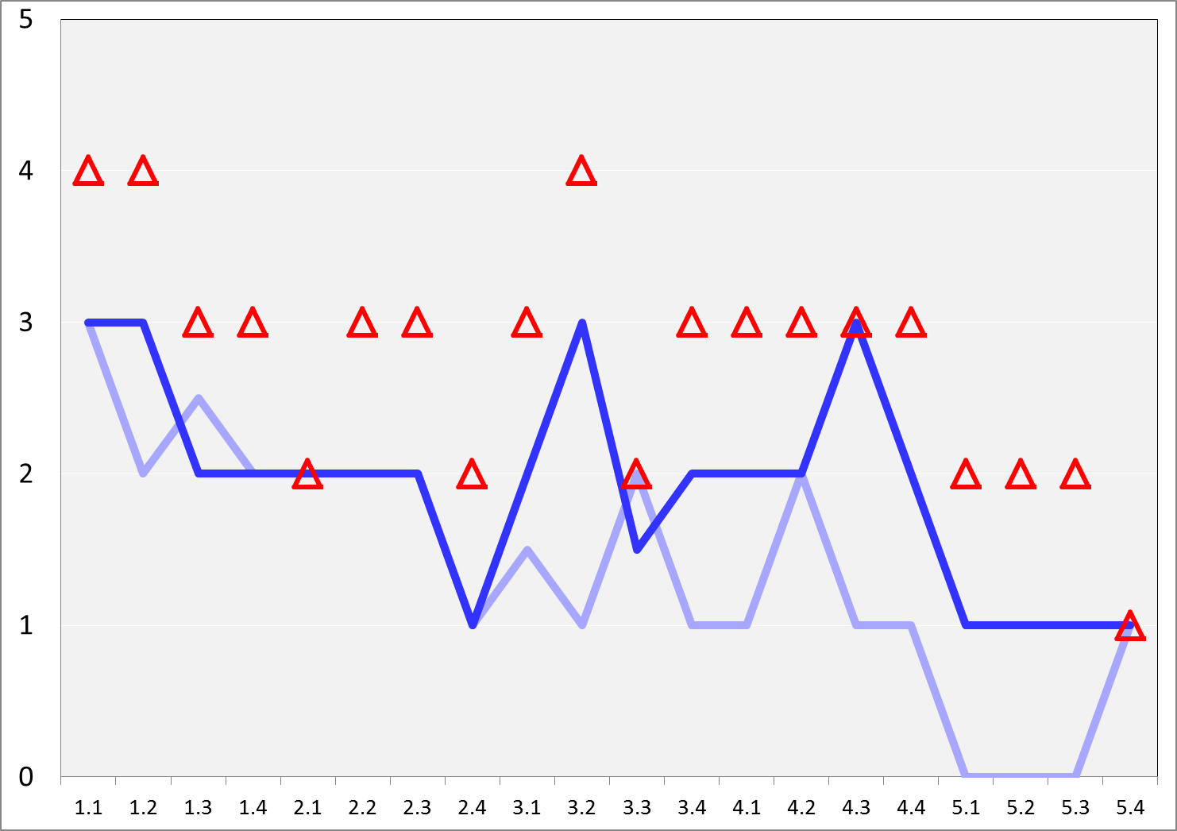
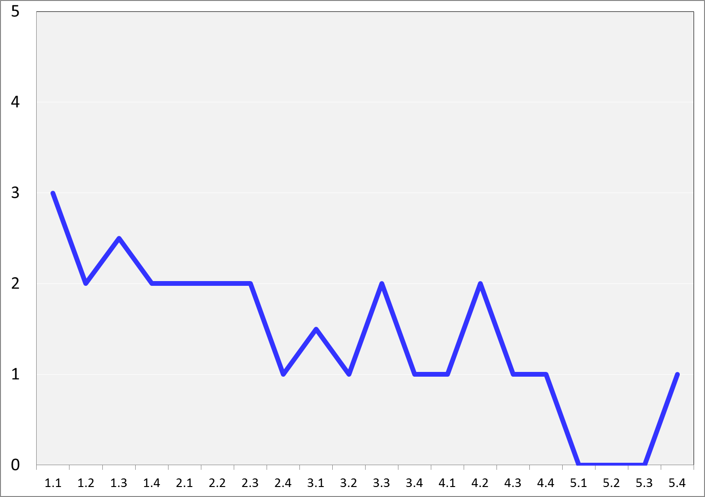
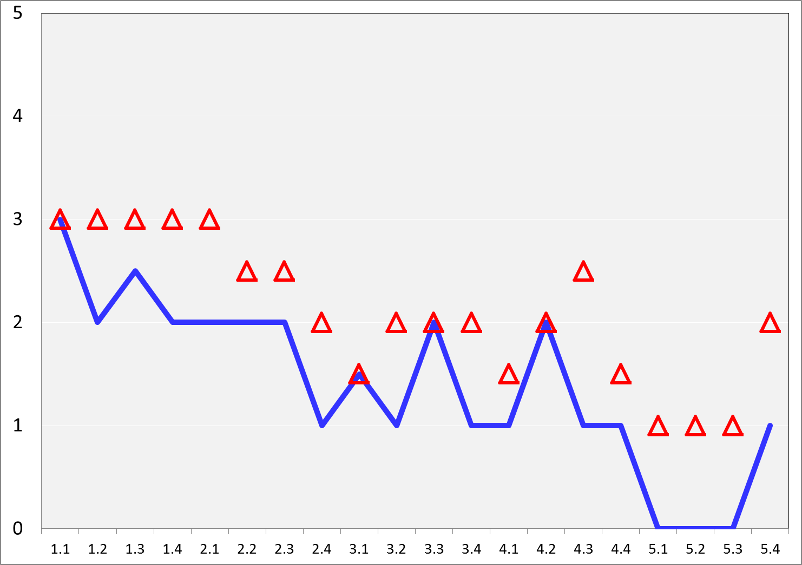
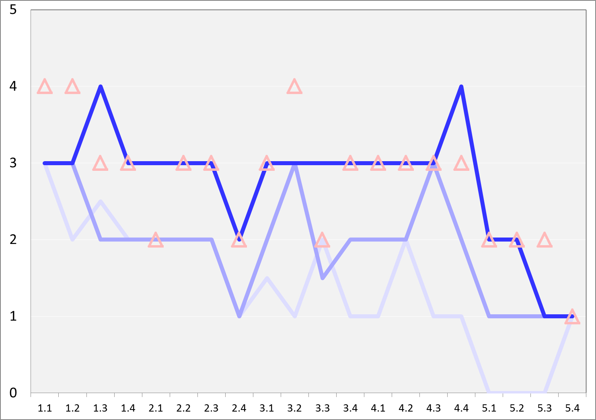
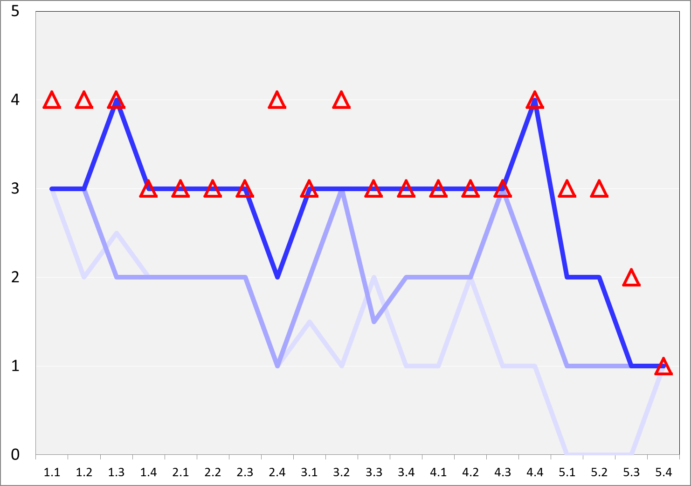
Case: Fontys University, School of Applied Sciences (2001 – 2008)

Slide 19
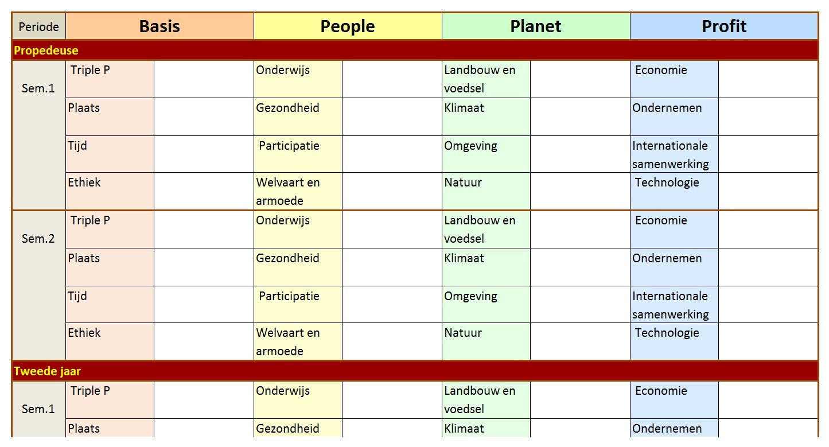
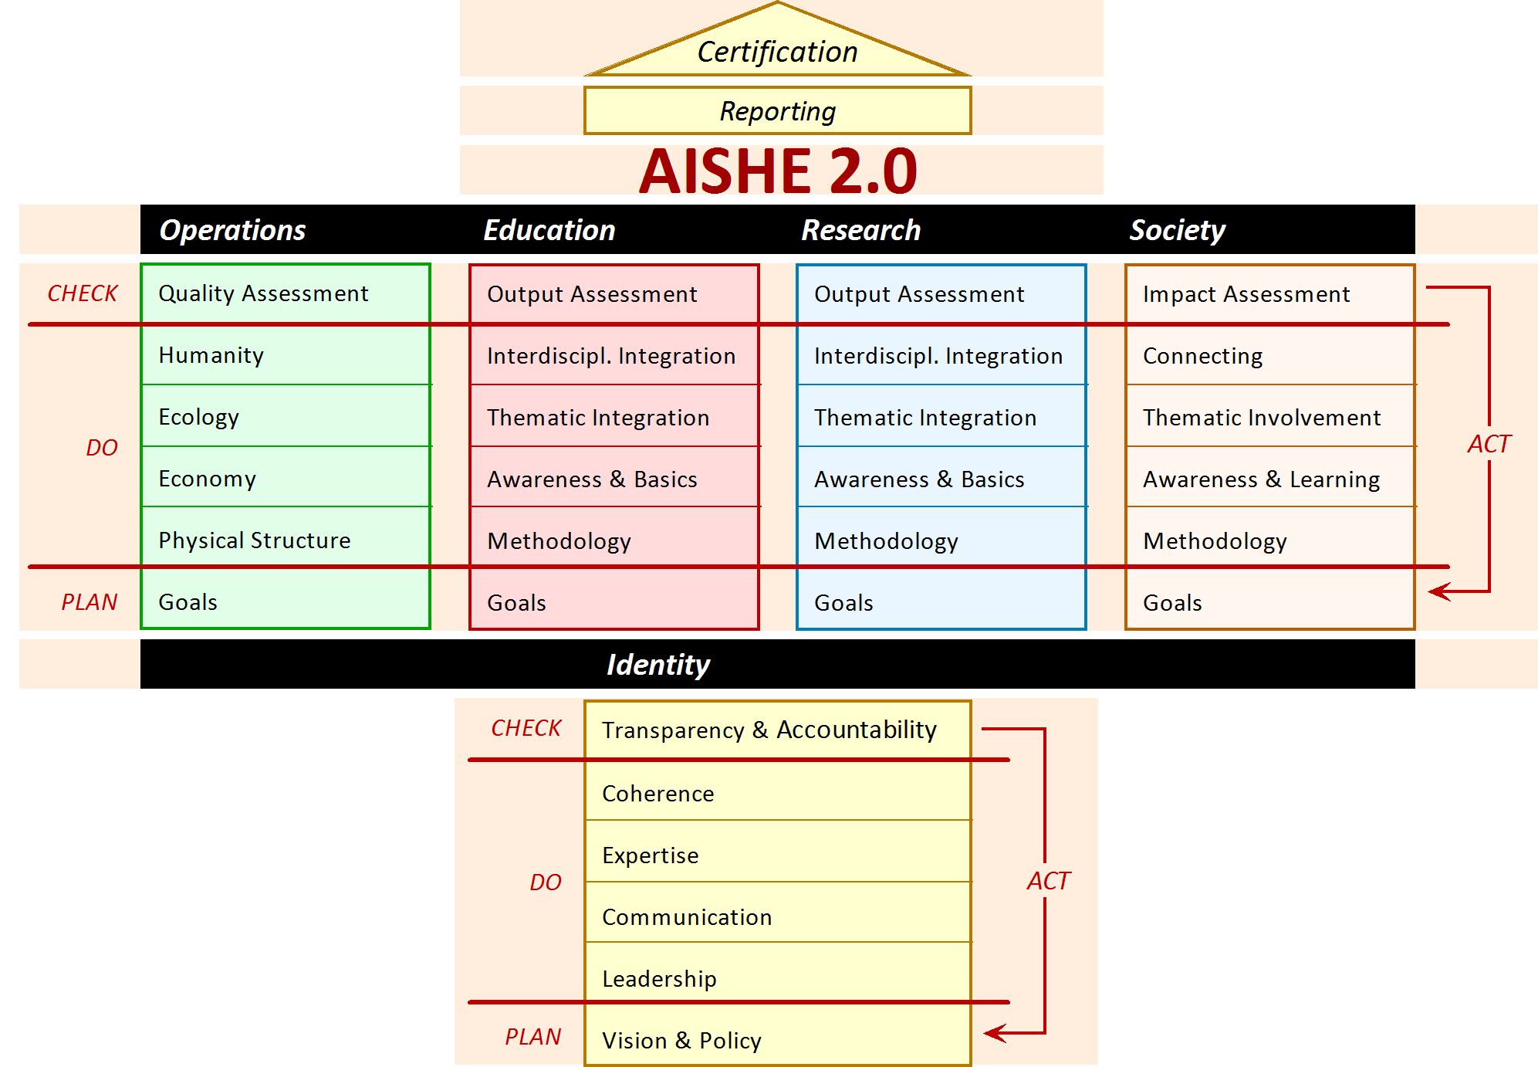
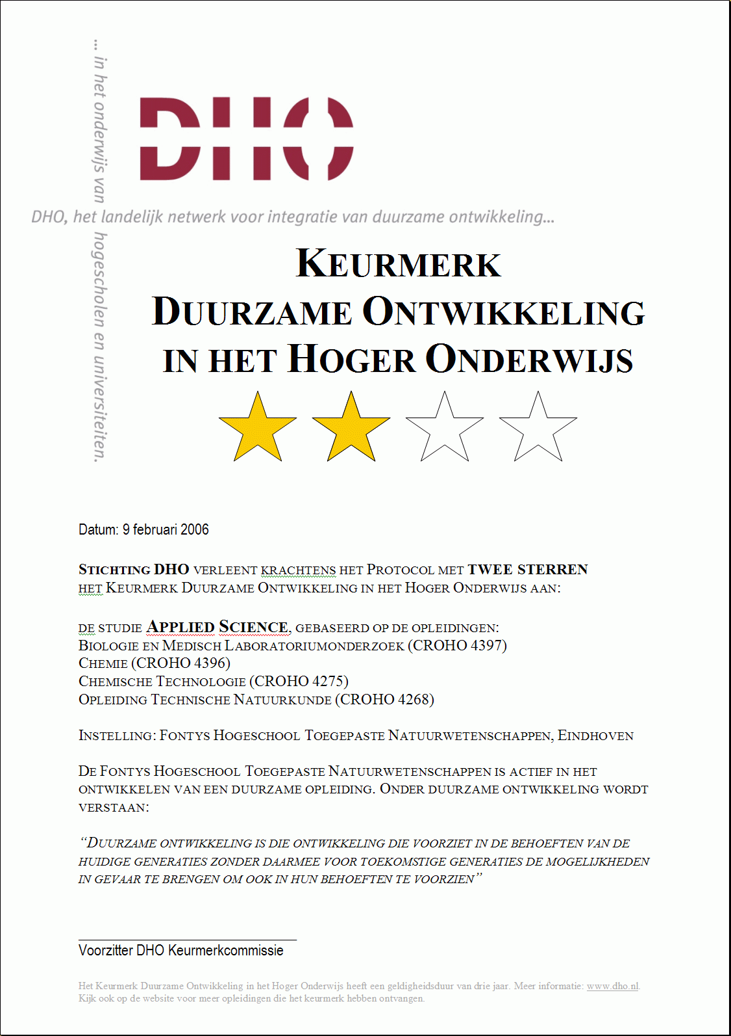
Instruments for organisation development
SD Curriculum Scan
AISHE
Tree Model
RESFIA+D : Professional competences for SD
Competence R: Responsibility | Competence E: Emotional intelligence
Competence S: System orientation | Competence F: Future orientation
Competence I: personal Involvement | Competence A: Action skills
+D: Disciplinary competences
Certificate
Basics textbook
RESFIA+D

Slide 20
Strengths & Weaknesses of AISHE (GBU analysis)
Strengths
Thorough scientific, educational & societal validation
AISHE 1.0: Many experiences (>300x in 11 countries)
Evaluation after 10 years of application (PhD Roorda, 2010)
AISHE 2.0: Covers all roles of a university
Part of a larger set of ESD tools (“Tree Model”)
Consensus approach leads to realistic assessment results
Not just an assessment instrument, also a tool for ESD strategy & support
Certificate stimulates continuous improvement (thanks to ‘star’ levels)
Strategy leads to SISD
Applicable outside of education → co-creation with companies towards SISD
Weaknesses
Application needs an experienced (& certified) assessor (← training program…)
Time-consuming: 1 assessment needs ca. 15 persons for most of a day
AISHE 2.0: no ‘owning’ organization
AISHE 2.0: no website, no software
AISHE 2.0: no certificate yet

Slide 21
AISHE for
Companies
(etc.)
Primary process
R&D, innovation

Slide 22
Instruments for organisation development
SD Curriculum Scan
AISHE
Tree Model
RESFIA+D : Professional competences for SD
Competence R: Responsibility | Competence E: Emotional intelligence
Competence S: System orientation | Competence F: Future orientation
Competence I: personal Involvement | Competence A: Action skills
+D: Disciplinary competences
Certificate
Basics textbook
RESFIA+D

Slide 23
Instruments for organisation development
AISHE
RESFIA+D : Professional competences for SD
Competence R: Responsibility | Competence E: Emotional intelligence
Competence S: System orientation | Competence F: Future orientation
Competence I: personal Involvement | Competence A: Action skills
+D: Disciplinary competences
RESFIA+D

Slide 24
RESFIA+D : Professional competences for SD
Competence R: Responsibility | Competence E: Emotional intelligence
Competence S: System orientation | Competence F: Future orientation
Competence I: personal Involvement | Competence A: Action skills
+D: Disciplinary competences

Slide 25
Competence R: Responsibility A sustainably competent professional bears responsibility for his or her own work. | Competence E: Emotional intelligence A sustainably competent professional empathises with the values and emotions of others.
1. Create a stakeholder analysis on the basis of the consequence scope and the consequence period | 1. Recognise and respect his or her own values and those of other people and cultures
2. Take personal responsibility | 2. Distinguish between facts, assumptions and opi-nions
3. Be held personally accountable with respect to society (transparency) | 3. Cooperate on an interdisciplinary and transdisciplinary basis
Competence S: System orientation A sustainably competent professional thinks and acts from a systemic perspective. | Competence T: Future orientation A sustainably competent professional works and thinks on the basis of a perspective of the future.
1. Think from systems: flexibly zoom in and out on issues, i.e. thinking analytically and holistically in turn | 1. Think on different time scales – flexibly zoom in and out on short and long term approaches
2. Recognise flaws in the fabric and sources of vigour in systems; have the ability to use the sources of vigour | 2. Recognise and utilise non-linear processes
3. Think integrally and chain oriented | 3. Think innovatively, creatively, out of the box
Competence I: personal Involvement A sustainably competent professional has a personal involvement in sustainable development. | Competence A: Action skills A sustainably competent professional is decisive and capable of acting.
1. Consistently involve sustainable development in the own work as a professional (sustainable attitude) | 1. Weigh up the unweighable and make decisions
2. Passionately work towards dreams and ideals | 2. Deal with uncertainties
3. Employ his or her conscience as the ultimate yardstick | 3. Act when the time is right, and not go against the current: ‘action without action’

Slide 26
Competence Levels:
 | Level 1: Apply | Level 2: Integrate | Level 3: Improve | Level 4: Innovate
Example: E: Emotional intelligence: E1. Recognise and respect his or her own values and those of other people and cultures | You formulate the values from which you think and act as a professional. | You formulate the values from which others think and act who are involved or have an interest in your professional actions. You ‘listen actively’ to others, and you communicate respectfully with these others about the differences in values. | You cooperate with these others, during which you utilize both the similarities and the differences of the values as an enrichment and reinforcement of the quality of your activities. | You enrich and reinforce the quality of your professional activities by actively expanding the cooperation to people or cultures with other values.
Step 1: Which levels should your graduates have?
Step 2: Which levels are described in the current competence profile?
Step 3: Which levels are realized in your current curriculum?
Step 4: Which improvements should be the first priorities?

Slide 27
