Slide 1
“AISHE”: Assessment of
Sustainable Development in Higher Education
ISLE Summer School
July 2011, Malta
Niko Roorda, PhD
Notes:
1

Slide 2


Slide 3
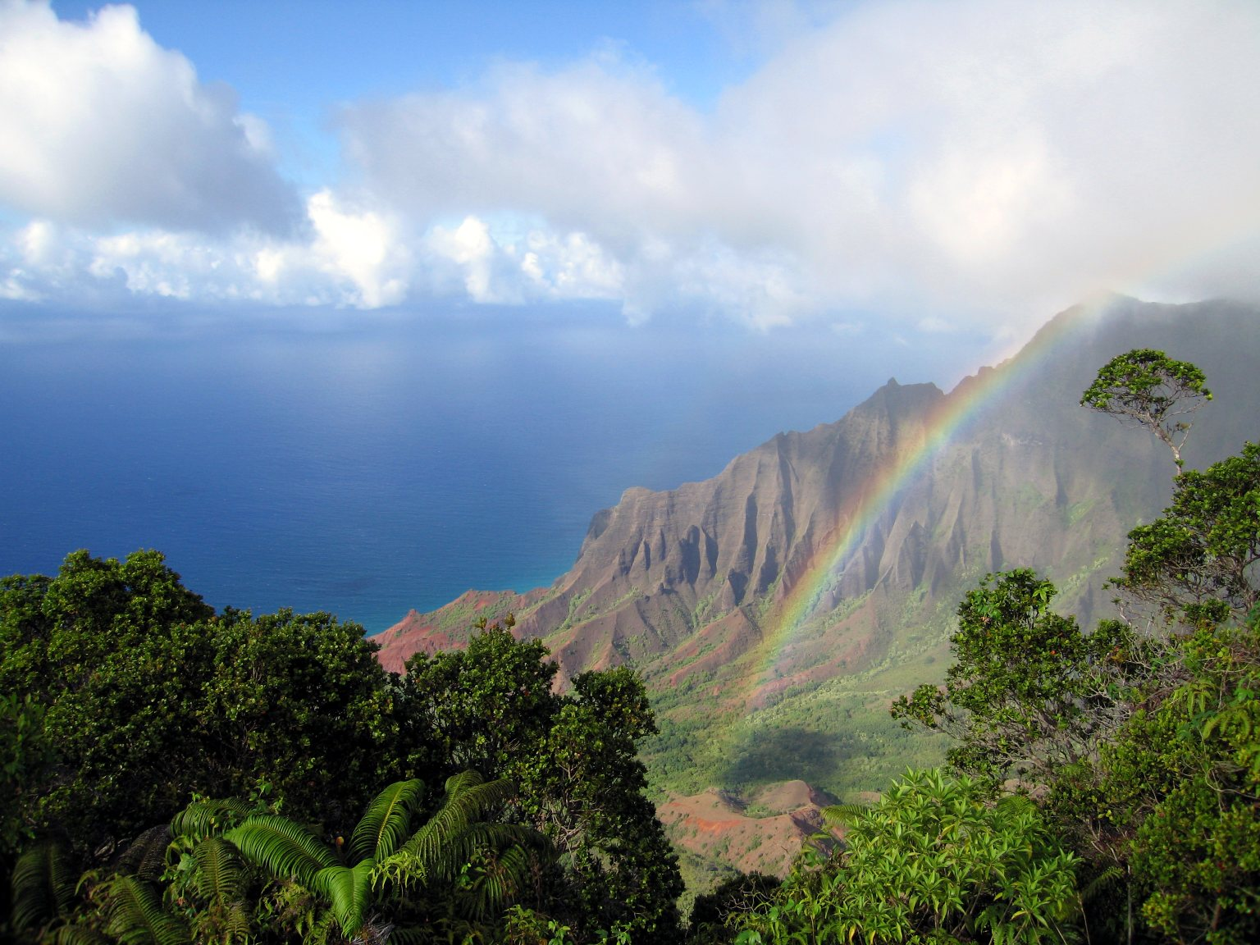

Slide 4

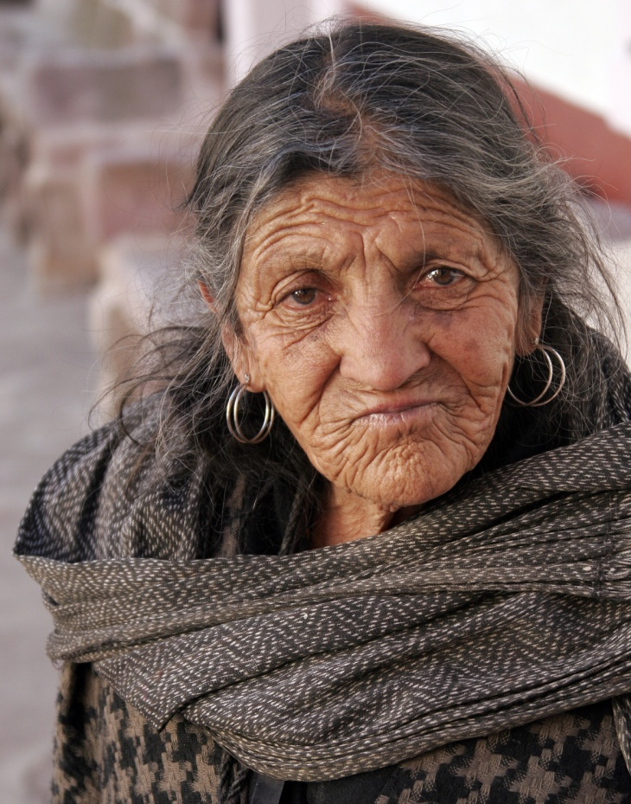
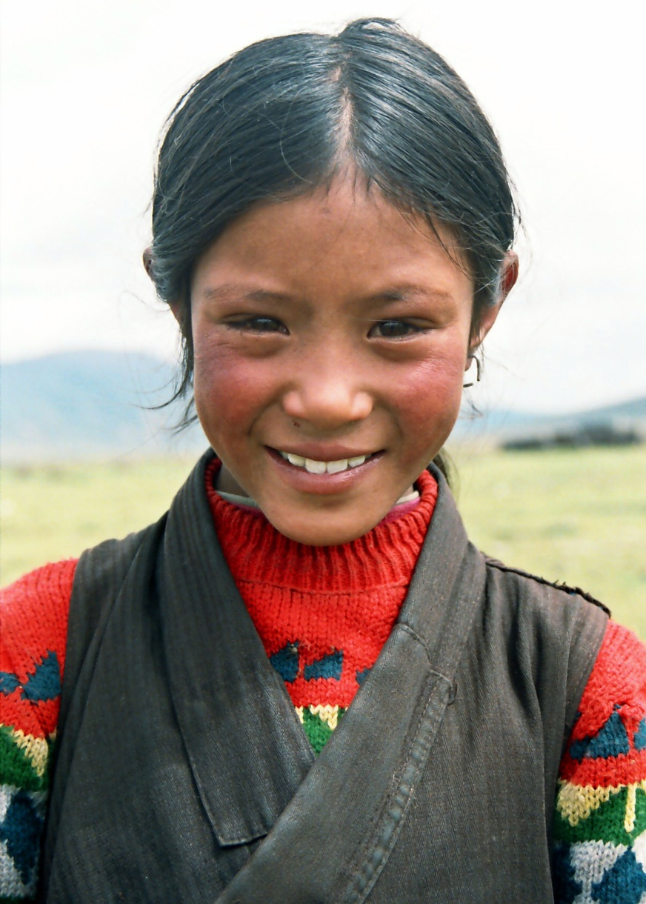
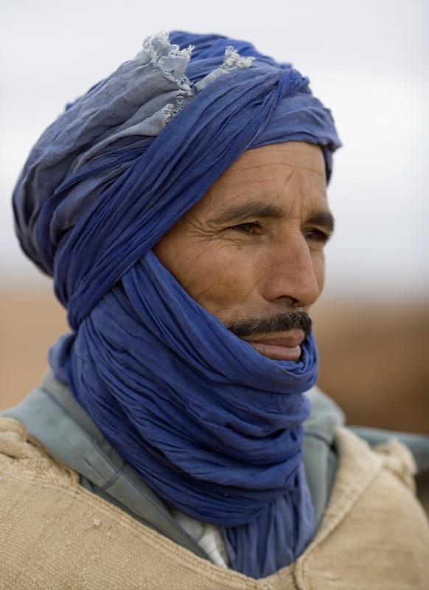
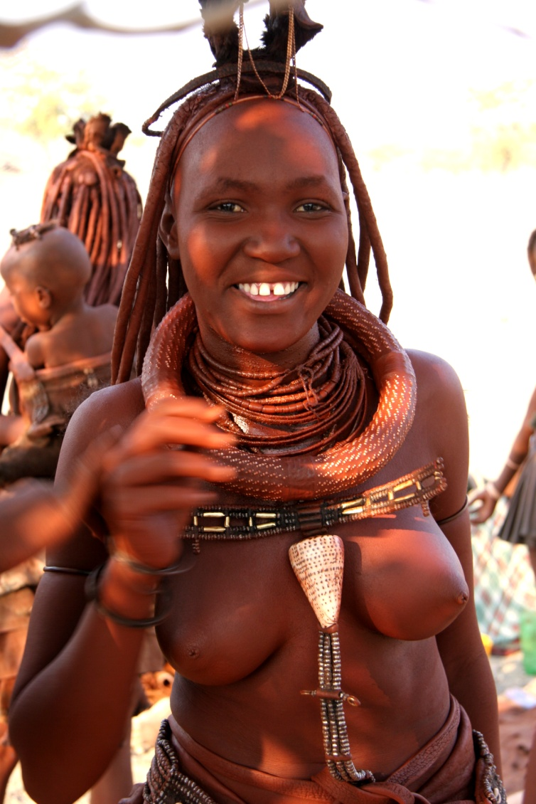

Slide 5
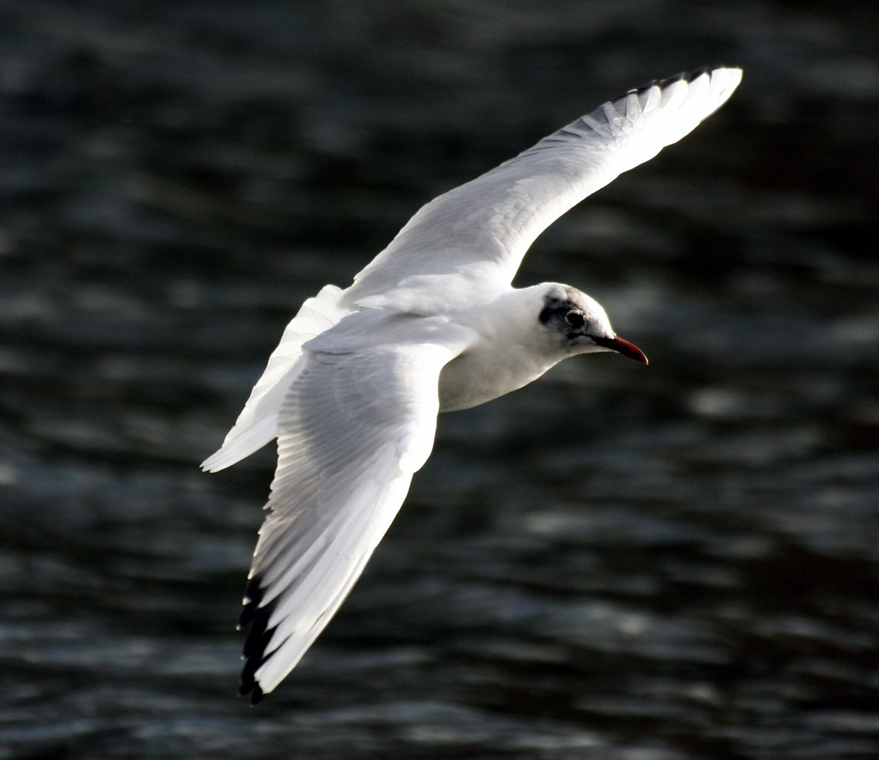
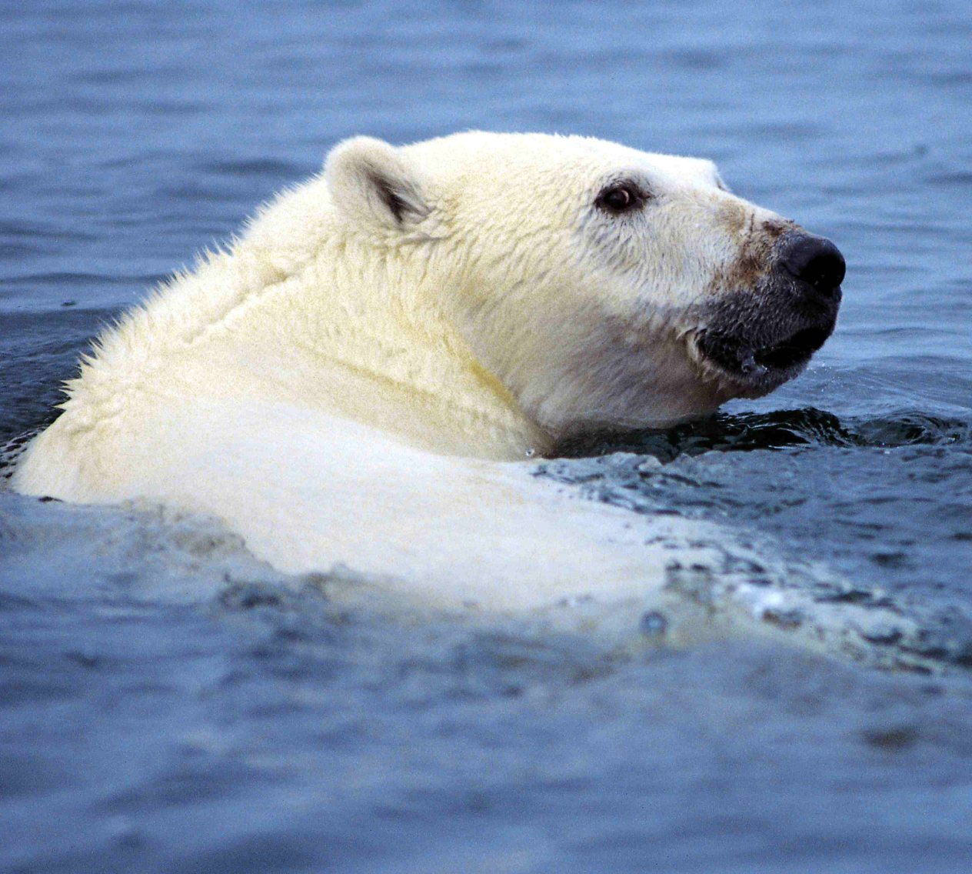
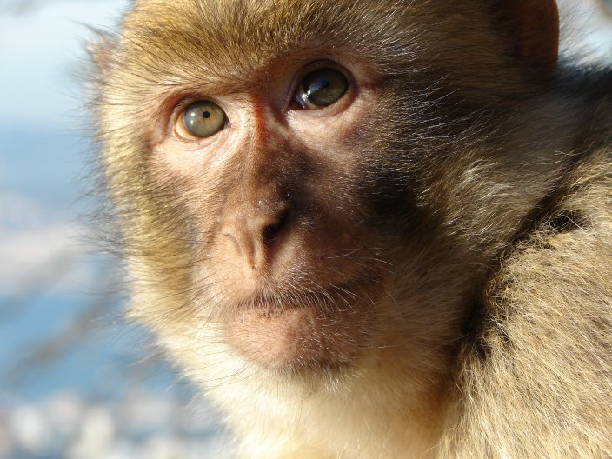
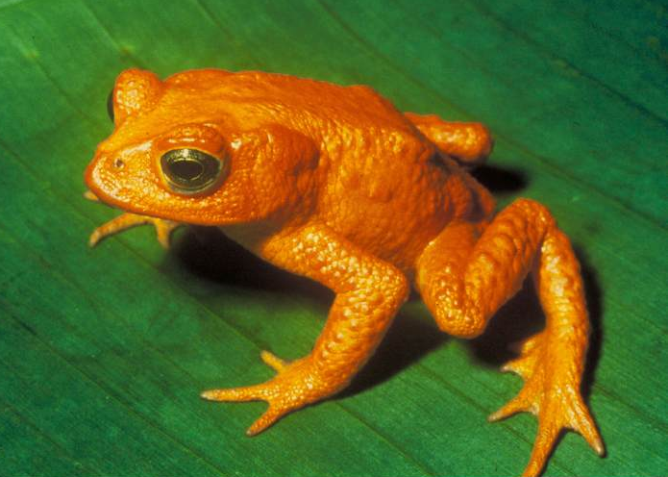

Slide 6
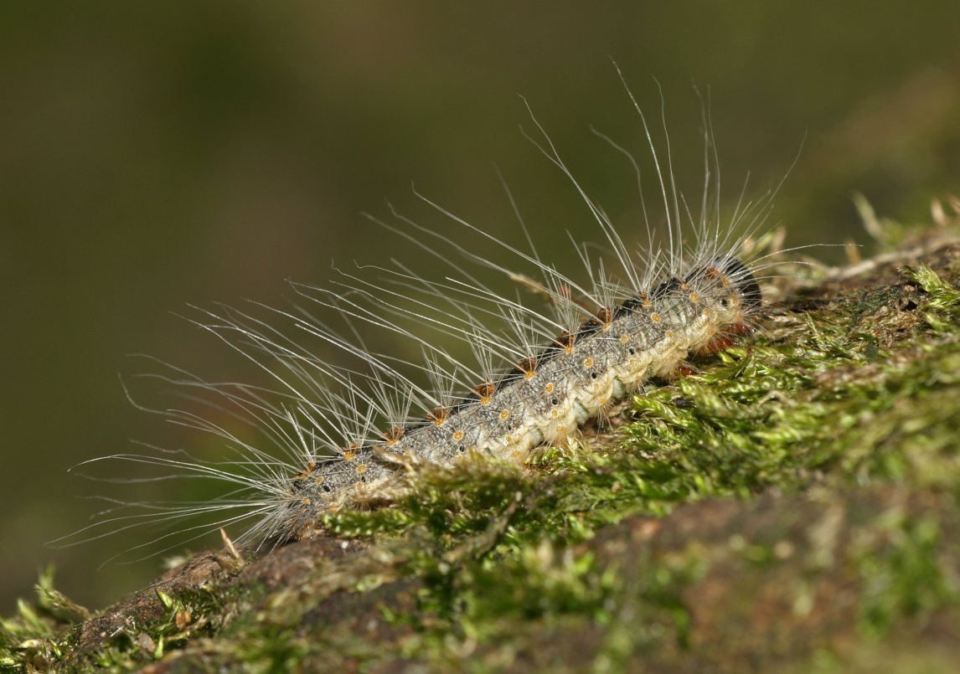
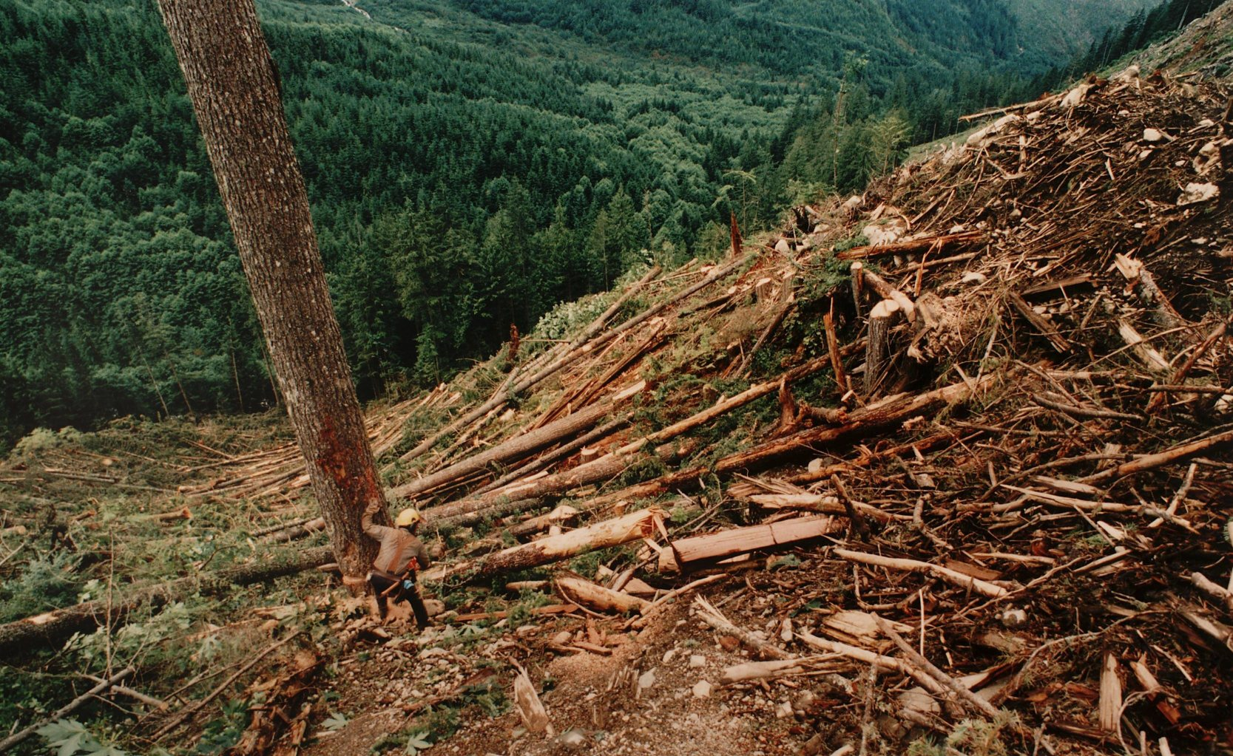
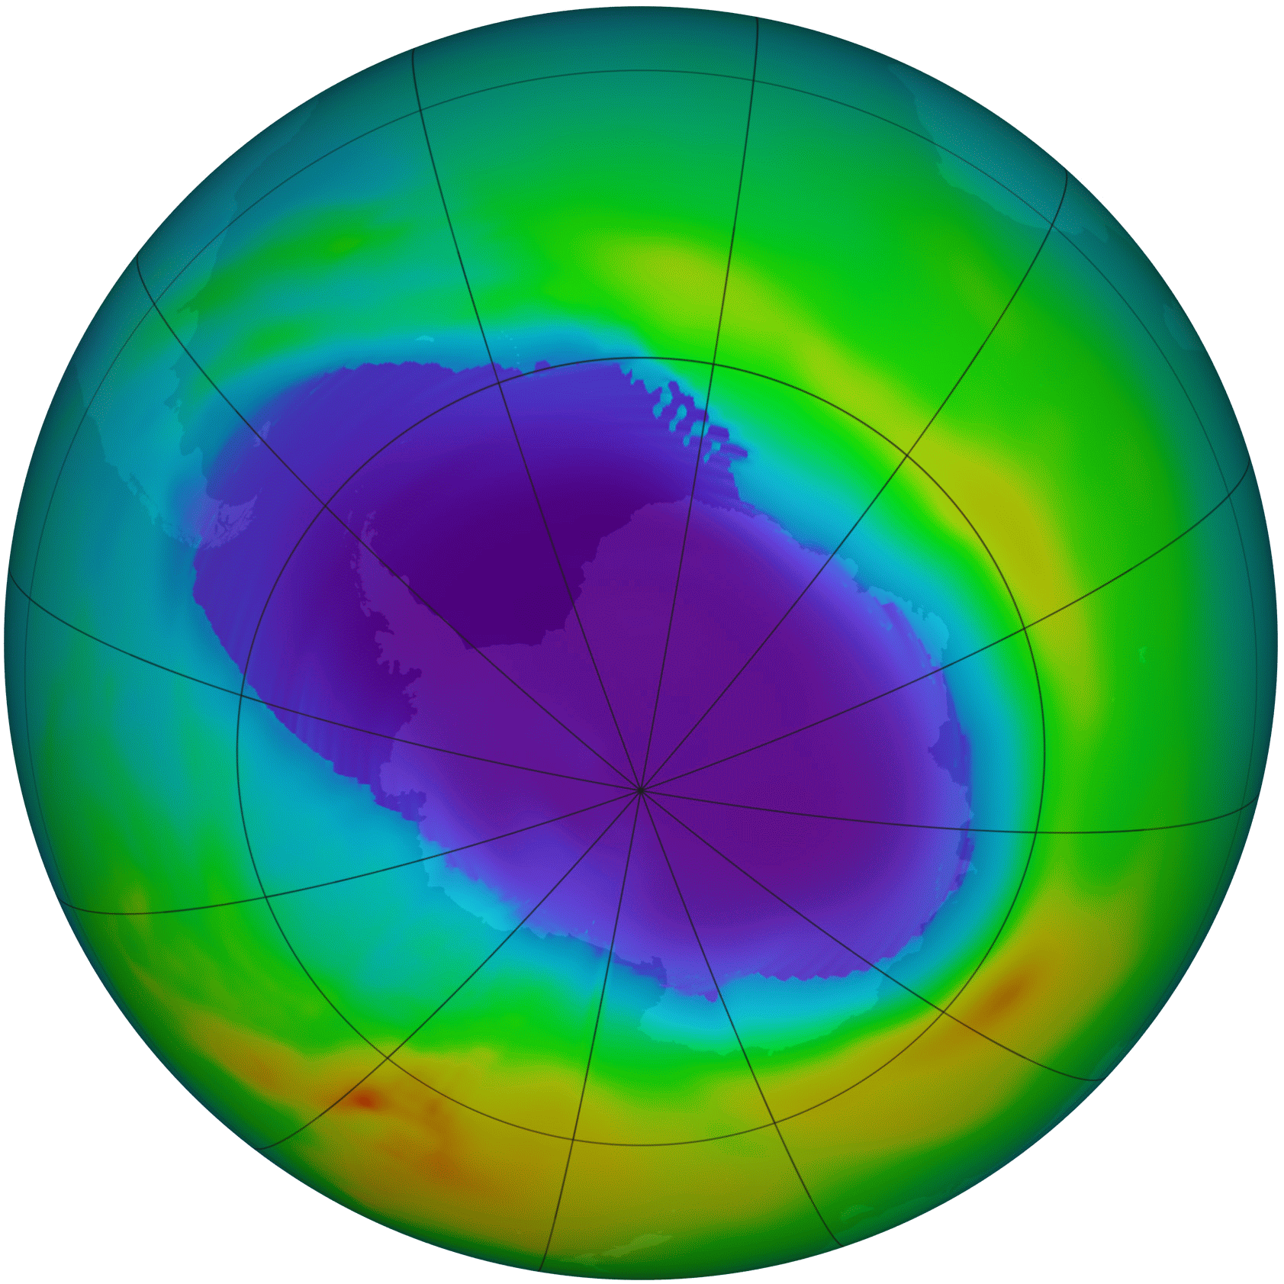
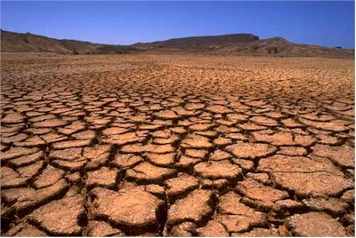

Slide 7
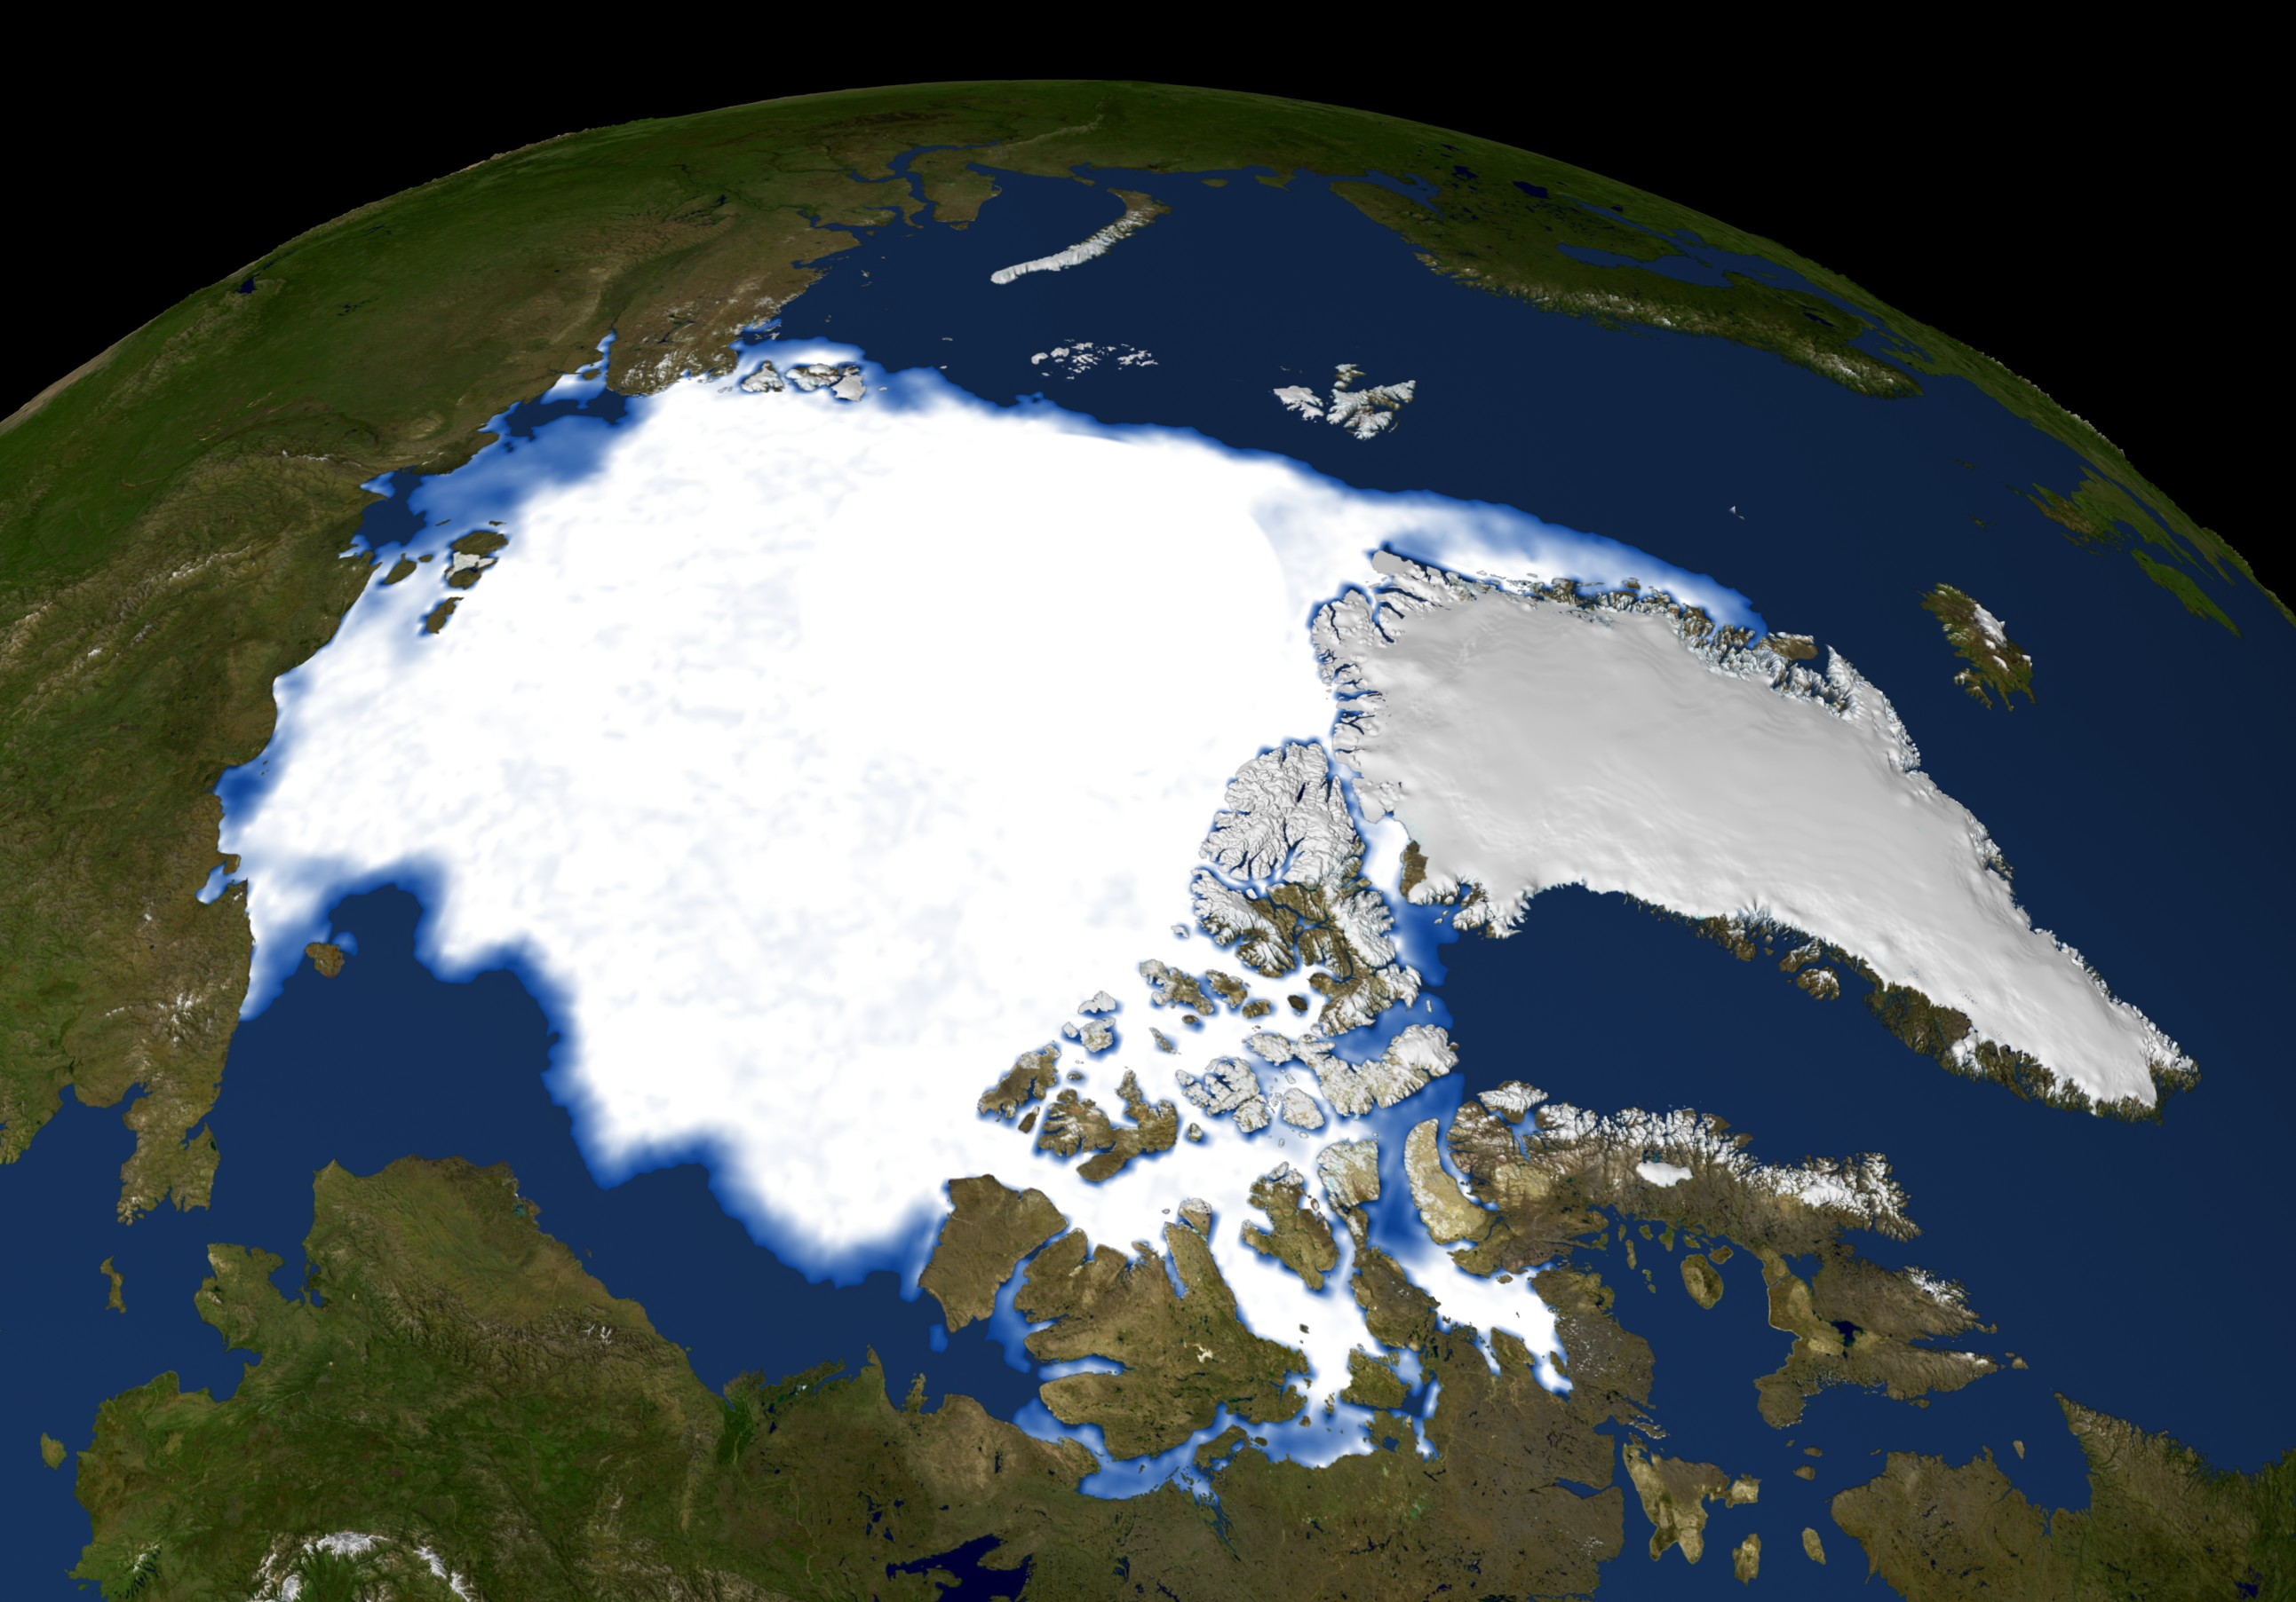
1979
Notes:
7

Slide 8
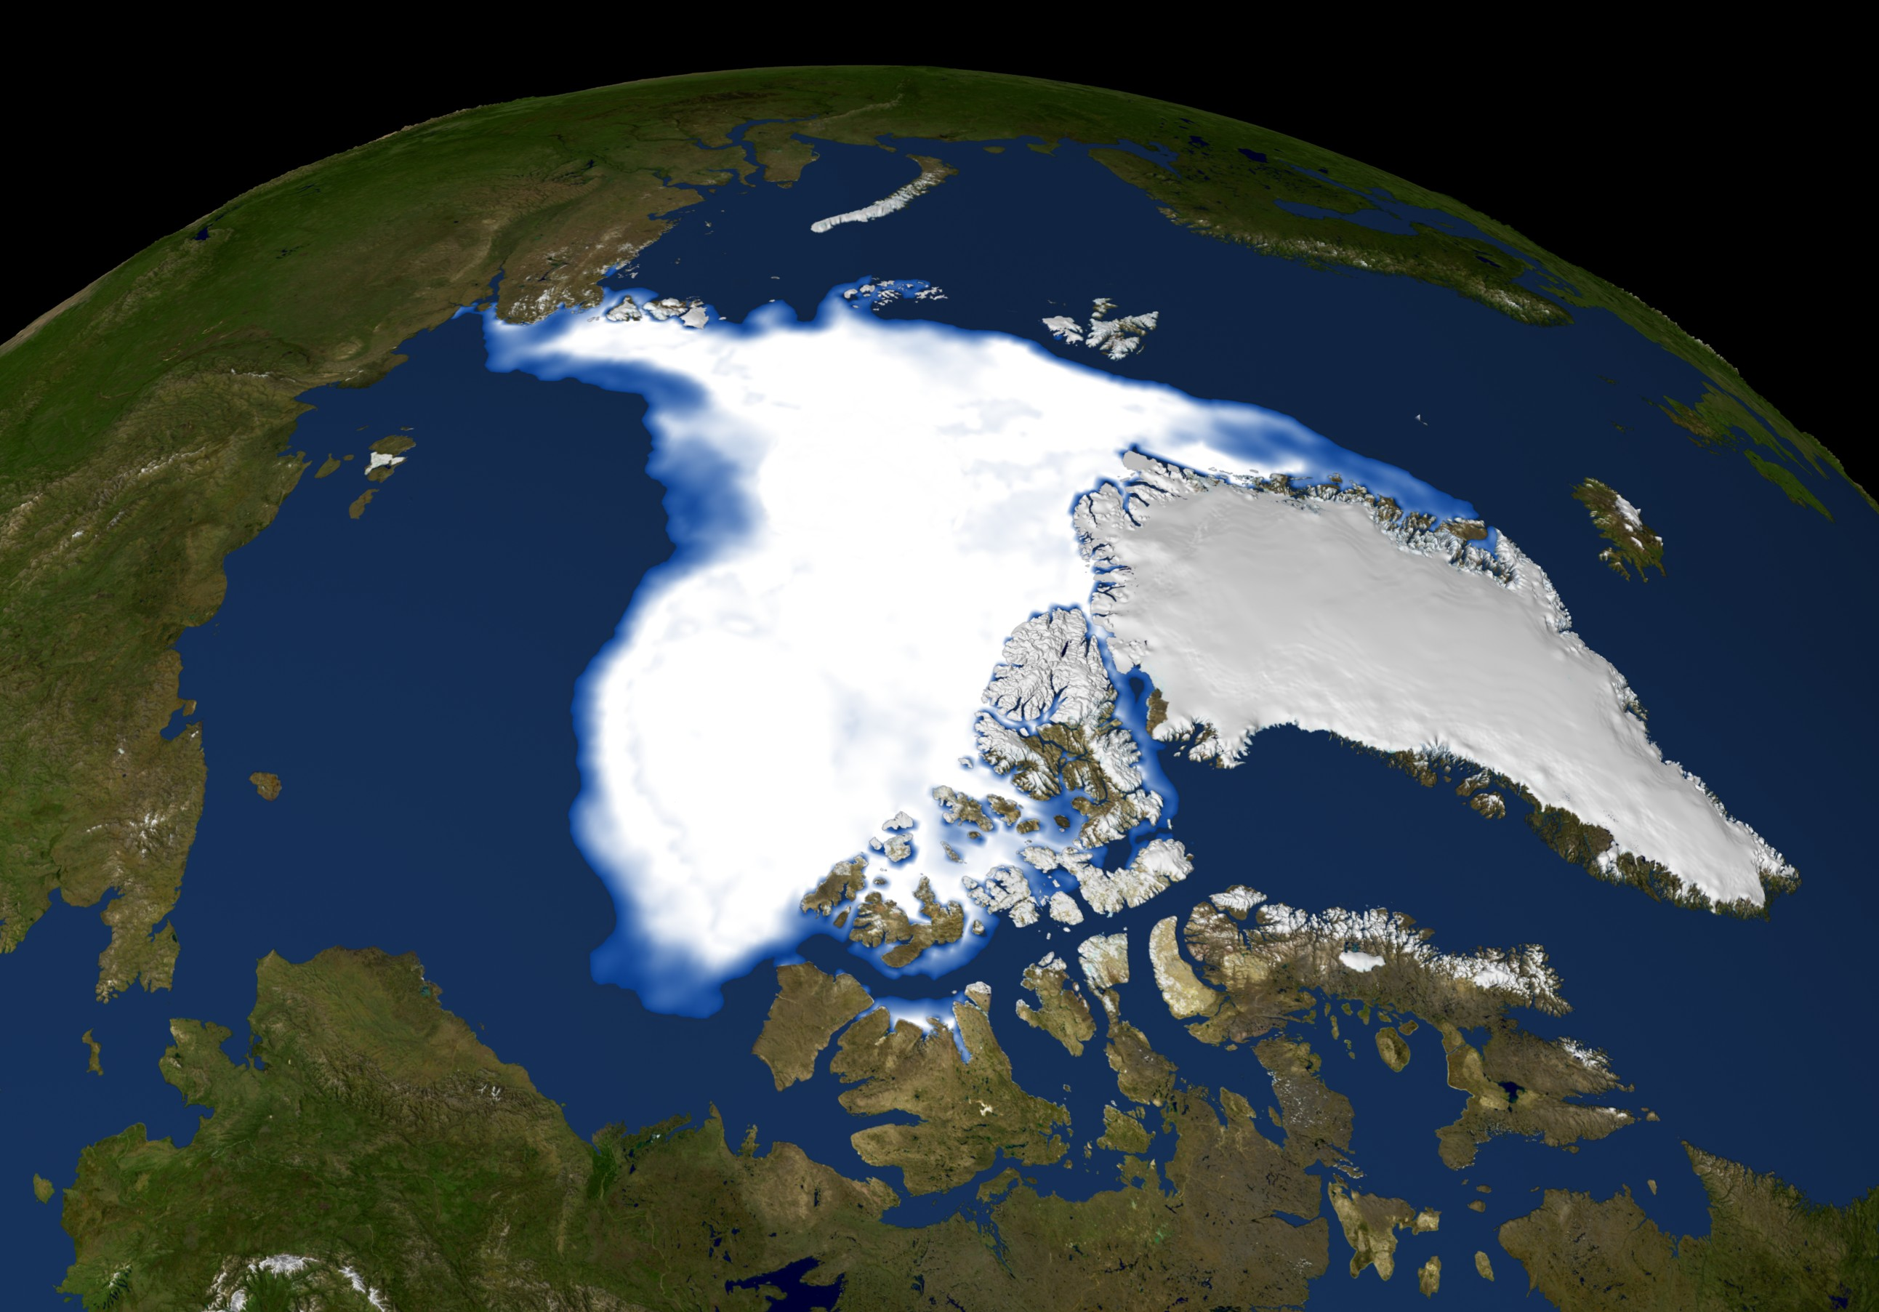
2007
Notes:
8

Slide 9
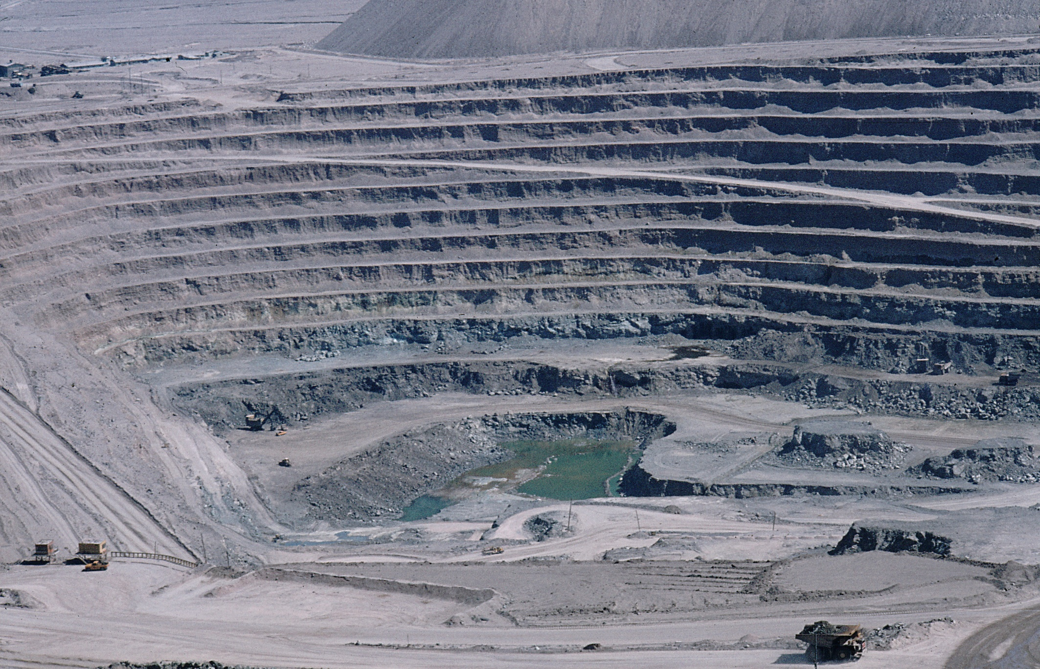
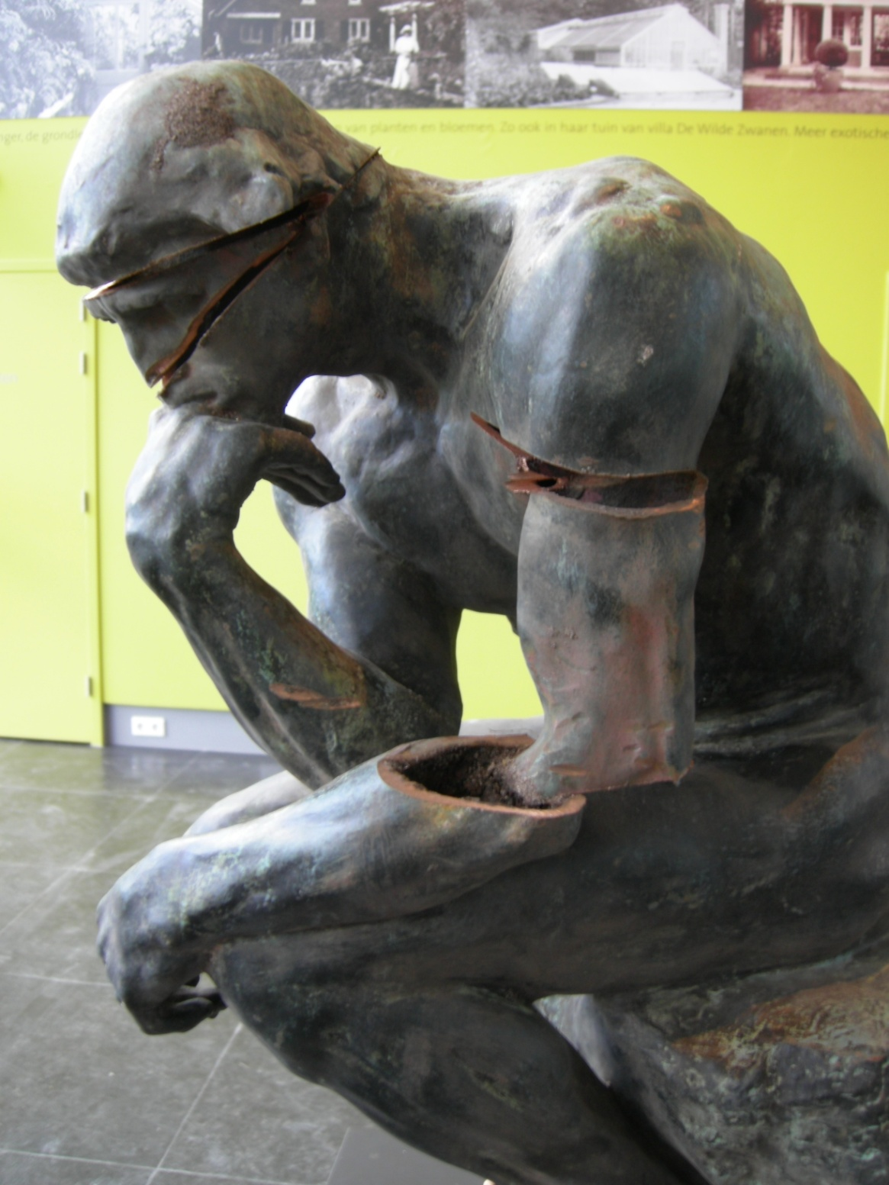

Slide 10
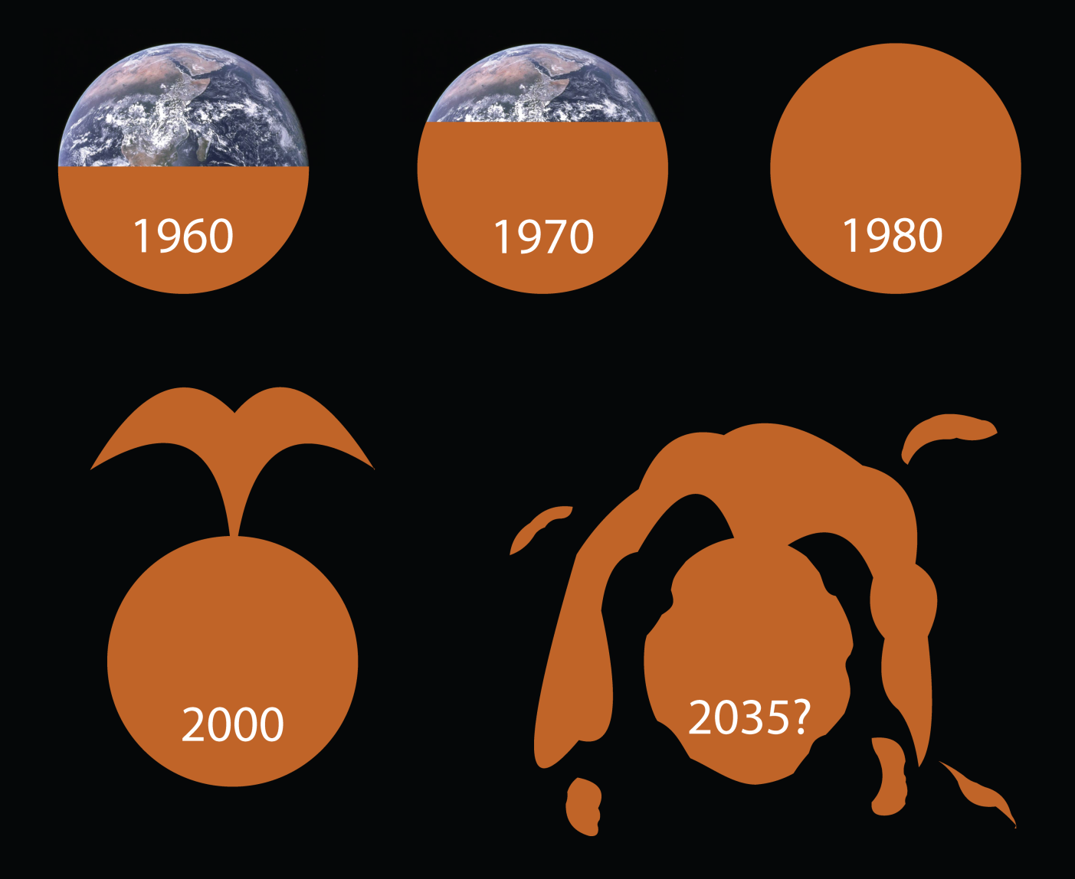
Biocapacity of Planet Earth

Slide 11
Distribution of the use of the biocapacity
African
: 1,1
Dutchman
: 4,4
Chinese
: 1,6
American
(USA)
: 9,6
global hectares per capita

Slide 12
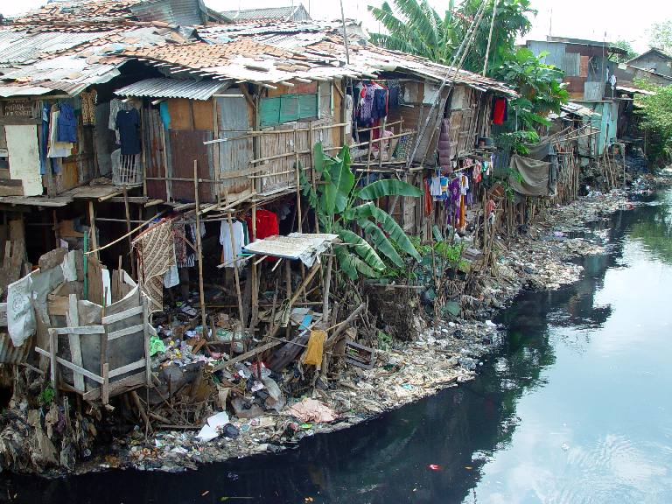
Notes:
12

Slide 13



People
Triple P
Planet
Profit / Prosperity

Slide 14
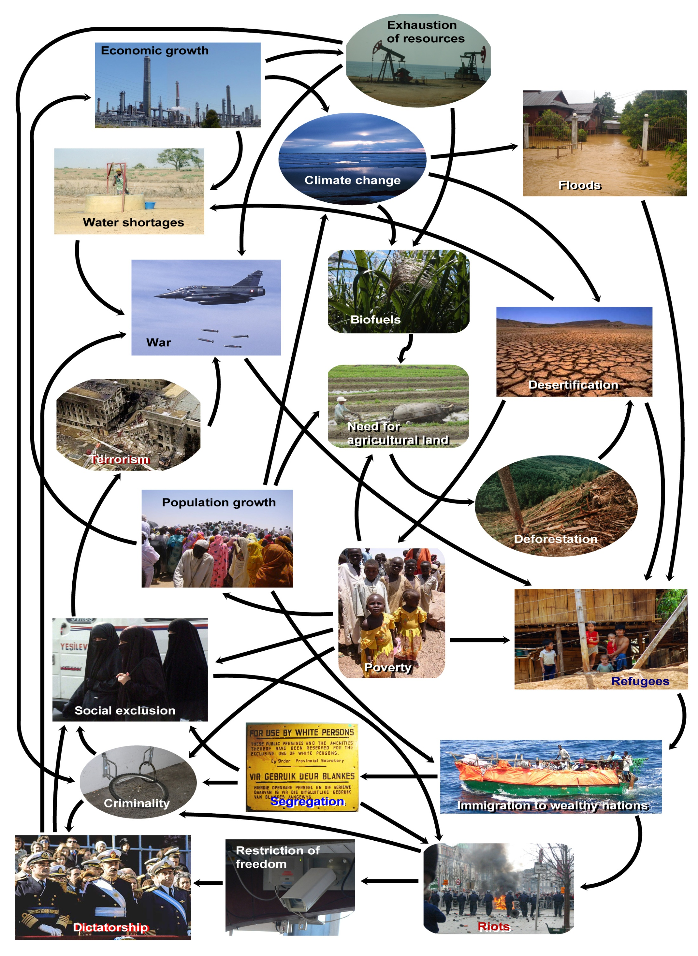

Slide 15
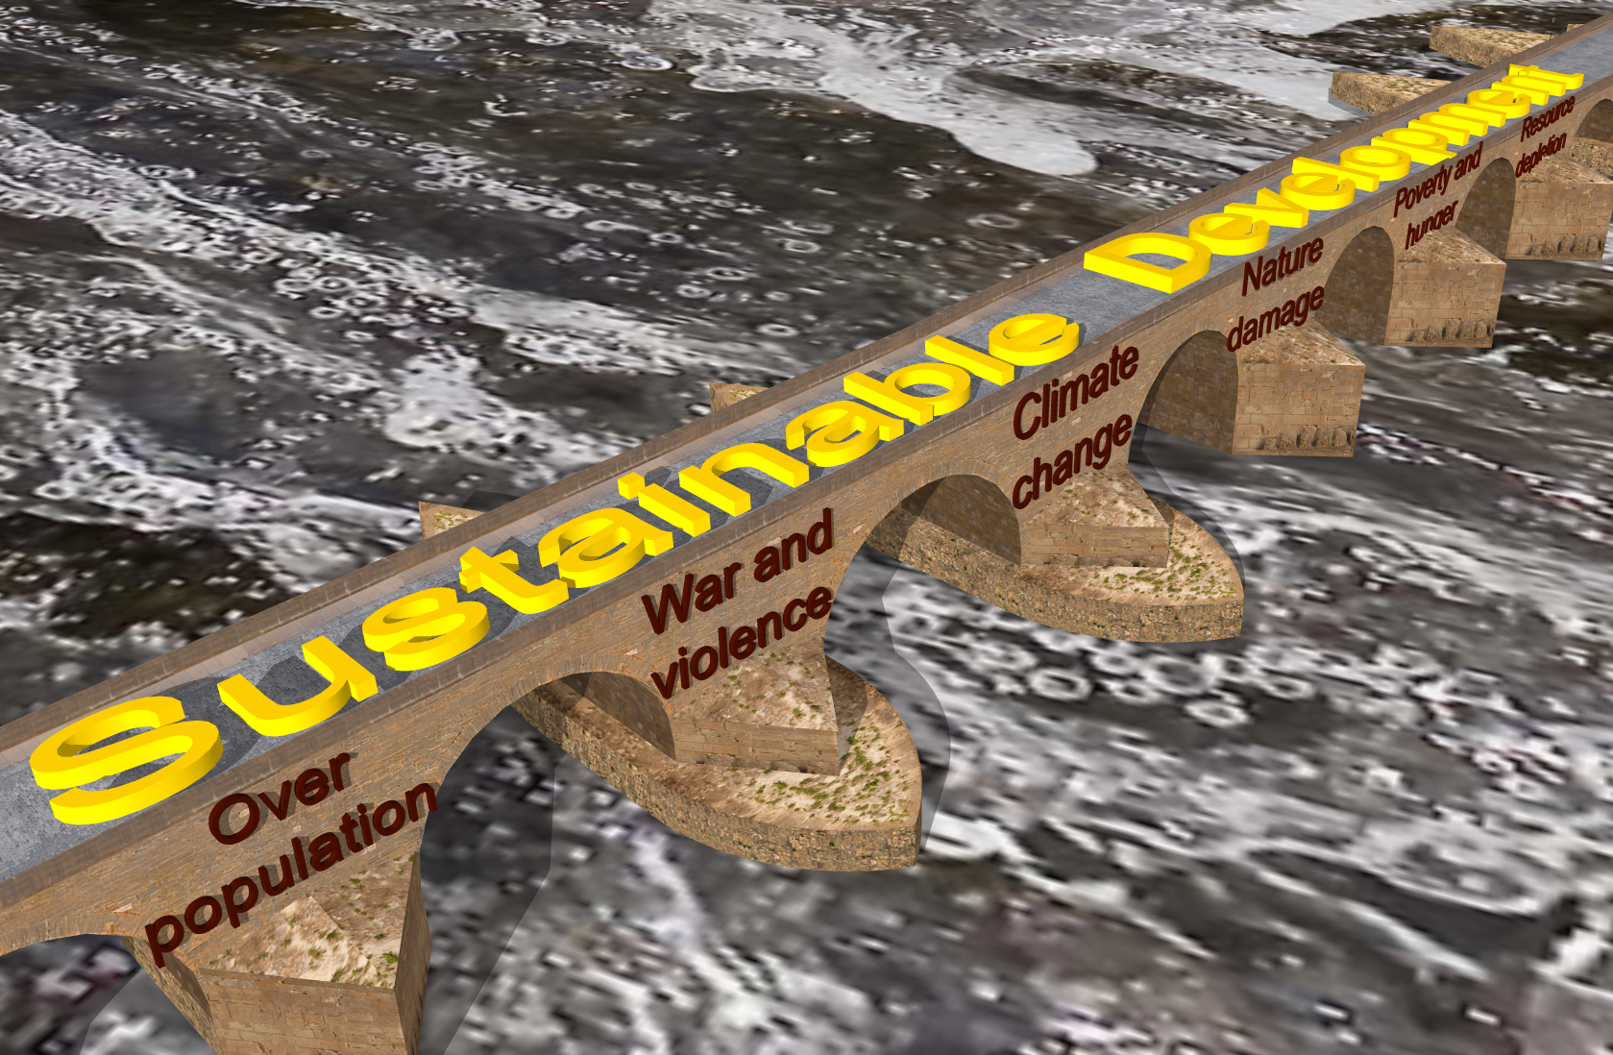

Slide 16
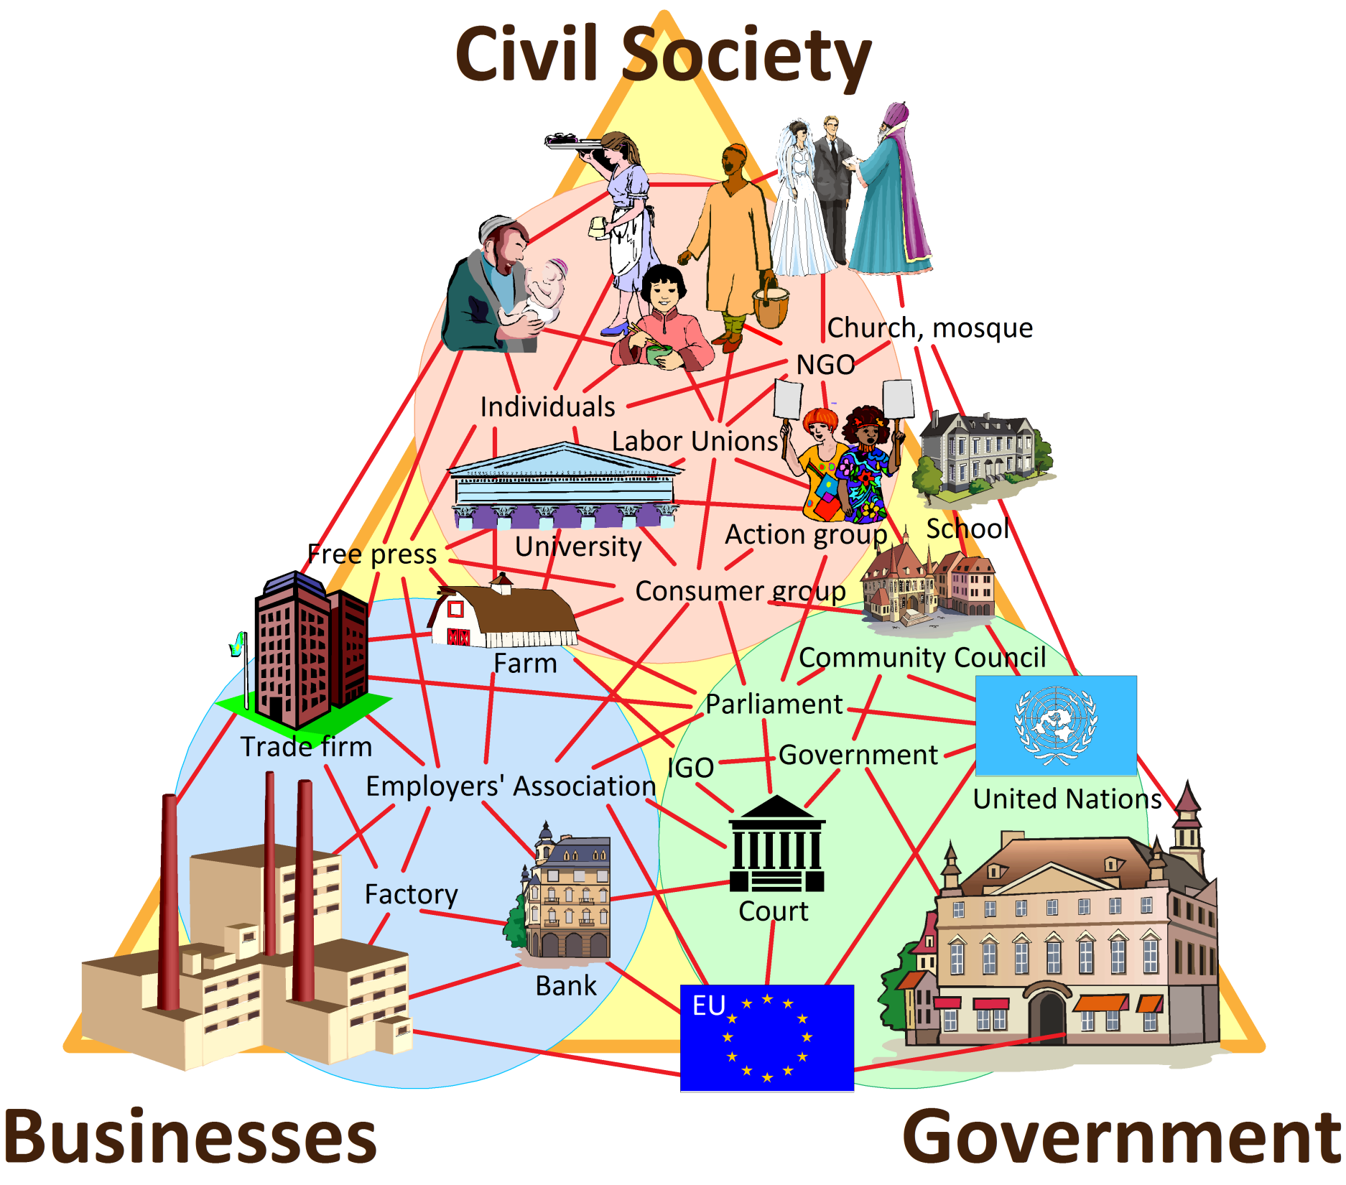

Slide 17
University
Teacher
Lecturer
Lecturer
Teacher
Lecturer
Professor
Professor
Lecturer
Student
Student
Student
Student
Student
Student
Student
Student
Student
Student
Student
Student
Student
Student
Student
Student
Student
Student
Student
Student
Student
Student
Student
Student
Student
Student
Student
Student
Student
Student
Student
Student
Student
Student
Student
Student
Student
Student
Student
Student
Student
Student
Student
Student
Student
Student
Student
Student
Student
Student
Student
Student
Student
Student
Student
Student
Student
Student
Student
Student
Student
Student
Student
Student
Student
Student
Student
Student
Student
Student
Student
Student
Student
Student
Student
Student
Student
Student
Student
Student
Student
Student
Student
Student
Student
Student
Student
Student
Student
Student
Student
Student
Student
Student
Student
Student
Student
Student
Student
Student
Student
Student
Student
Student
Student
Student
Student
Student
Student
Student
Student
Student
Student
Student
Student
Student
Student
Student
Student
Student
Student
Student
Student
Student
Student
Student
Student
Student
Student
Student
Student
Student
Student
Student
Student
Student
Student
Student
Student
Student
Student
Student
Student
Student
Student
Student
Student
Student
Student
Student
Student
Student
Student
Student
Student
Student
Student
Student
Student
Student
Student
Student
Student
Student
Student
Student
Student
Student
Student
Student
Student
Student
Student
Student
Student
Student
Student
Student
Student
Student
Company
Company
Company
Office
Company
Government
Company
Company
Company
Company
Company
Company
Company
Company
Company
School
Office
Company
Company
Government
Company
Company
Company
Office
Company
Company
Company
Company
Company
Government
Company
School
Company
Company
Company
Company
Company
Company
Office
Office
Company
Company
Company
Company
Government
Company
Government
School
Company
Company
Company
Bank
Company
Company
Hospital
Company
Company
Company
Company
Company
Company
School
School
Company
Company
Company
Company
Company
Company
Company
Office
Bank
Company
Company
Company
Company
Company
Government
Company
Company
Company
Company
Hospital
Bank
Company
Company
Company
Company
Company
Company
Company
Company
Company
Company
Hospital
Company
Company
Company
Company
School
Government
Company
Bank
Bank
School
Company
Company
Company
Company
Company
Company
Hospital
Hospital
Company
Company
Company
Company
Company
Company
Company
Company
Company
Company
Office
Company
Company
Company
Company
Company
Company
Company
Company
Government
Company
Company
Bank
School
Company
Company
Company
Company
Company
Company
Government
Hospital
School
Company
Office
Company
Company
Company
Company
Company
Company
Company
Company
Company
Office
Government
Government
School
School
Company
Company
Company
Company
Company
Office
Office
Company
Company
Company
Company
Government
Company
Company
Office
School
Company
Company

Slide 18
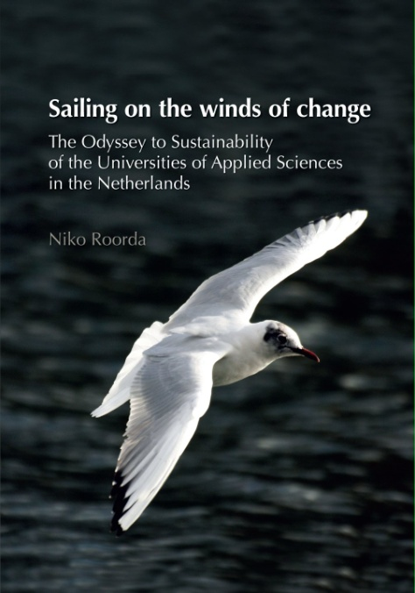
Education for Sustainable Development (ESD):
PhD study,
based on ESD experiments
between 1991 and 2010.
The pdf can be downloaded
from Niko Roorda’s
Linkedin page:
www.linkedin.com/in/nikoroorda
go to Full Profile
go to ‘Files’ section

Slide 19
Some characteristics of ESD
Principles | Characteristics | Details
Connectivity, complexity | Systems thinking | Connecting analytic and holistic approach; small with large; local with global
 | Multi-, inter- or transdisciplinary | Connecting disciplines and stakeholders
 | Life-cycle approach | Connecting phases in the lifecycle
 | Intercultural, international | Connecting people, cultures, regions, nations
 | Future orientation | Connecting the past, the present and the future
Innovativity | Openness to changing conditions | Flexibility of mind; capability of dealing with uncertainties
 | Openness to new solutions | Creativity, non-linearity, out of the box thinking
 | Function orientation | Zooming out from products or services to underlying functions or needs
Learning by doing | Application of knowledge | Aiming at finding useful solutions to real problems
 | Commitment | Personally engaged towards objectives of SD
 | Cooperation | Cooperation between experts, educators, students, professionals
Reflexivity | Learning to learn | Reflection on own learning process, lifelong learning
 | Responsibility | Personal responsibility for professional activities (stakeholder approach)
 | Value-driven | Aware of relevance and relativity of embedded values and opinions
 | Critical thinking | Critical attitude towards questions, tasks, methods, answers, own functioning
 | Robustness of information | Level of certainty of knowledge, data, conclusions

Slide 20




Slide 21
B

Slide 22

B

Slide 24

Inter- & transdisciplinary cooperation
Disciplinary focuses
Multidisciplinary relations
Methodologies
Basics: introduction to SD
Input: Mission, goals
Output: Effect on profession &society

Slide 25
(Re)design of Study Programme xxx:
Priority
++
++
–
+
–
+
++
+
Tree model:
Roots: Vision, mission, educational goals
Trunk: Basic module / introduction to SD
Biochemistry: Educational methodologies
Branches: Disciplinary focuses
Internal structure: Multidisciplinary integration
Forest, ecosystem: Interdisciplinary integration
Growth process: Development & maintenance of
study programme
Fruits: Output: effect on professions &
society
Input
Process
Output

Slide 26
Educational methodologies
‘Classic’ education, lectures, etc.
Problem based learning
Project education
Discussions
Research (by students)
Enterprises (by students)
Serious games
Reflection
Internships
Methodologies

Slide 27
Example: A math exercise
A PVC factory discharges waste water in a river (flow = 4000 l/min). (…)
At 12.31 AM, methyl-mercury-ethanolate is discovered in the waste water (3 ppm).
At 12.38 AM, the valve starts closing.
At 12.43 AM it is closed.
The flow as a function of time is sine-shaped.
A. How many grams of M-M-E are discharged at least?
B. And how many grams at most?
C. What happened between 12.31 and 12.38 AM?
D. What instruction do you give to the press officer?

Slide 28
PBL exercise: Tensions in the town
Tensions in the town are rising. Tonight there were fights between Muslim and Catholic teenagers. Last week, the windows of the church were smashed, after the mosque had been smudged with dirt and paint. The town council is desperate.
The police wants the town councilors to decide about actions. The mayor threatens to take steps all by himself, if they can’t get the situation in control.
Right as they are moaning and swearing during a council meeting, they hear sirens. The telephone rings: the community centre is on fire.

Slide 29
Research exercise: Water and international law
Investigate the ‘rule of equitable apportionment’.
Answer the following questions:
What does this rule mean?
Where did it originate; and where was it applied for the first time?
Are there any examples where the rule was applied in conflicts concerning the use of water in or between countries? If so, was the application successful?

Slide 30
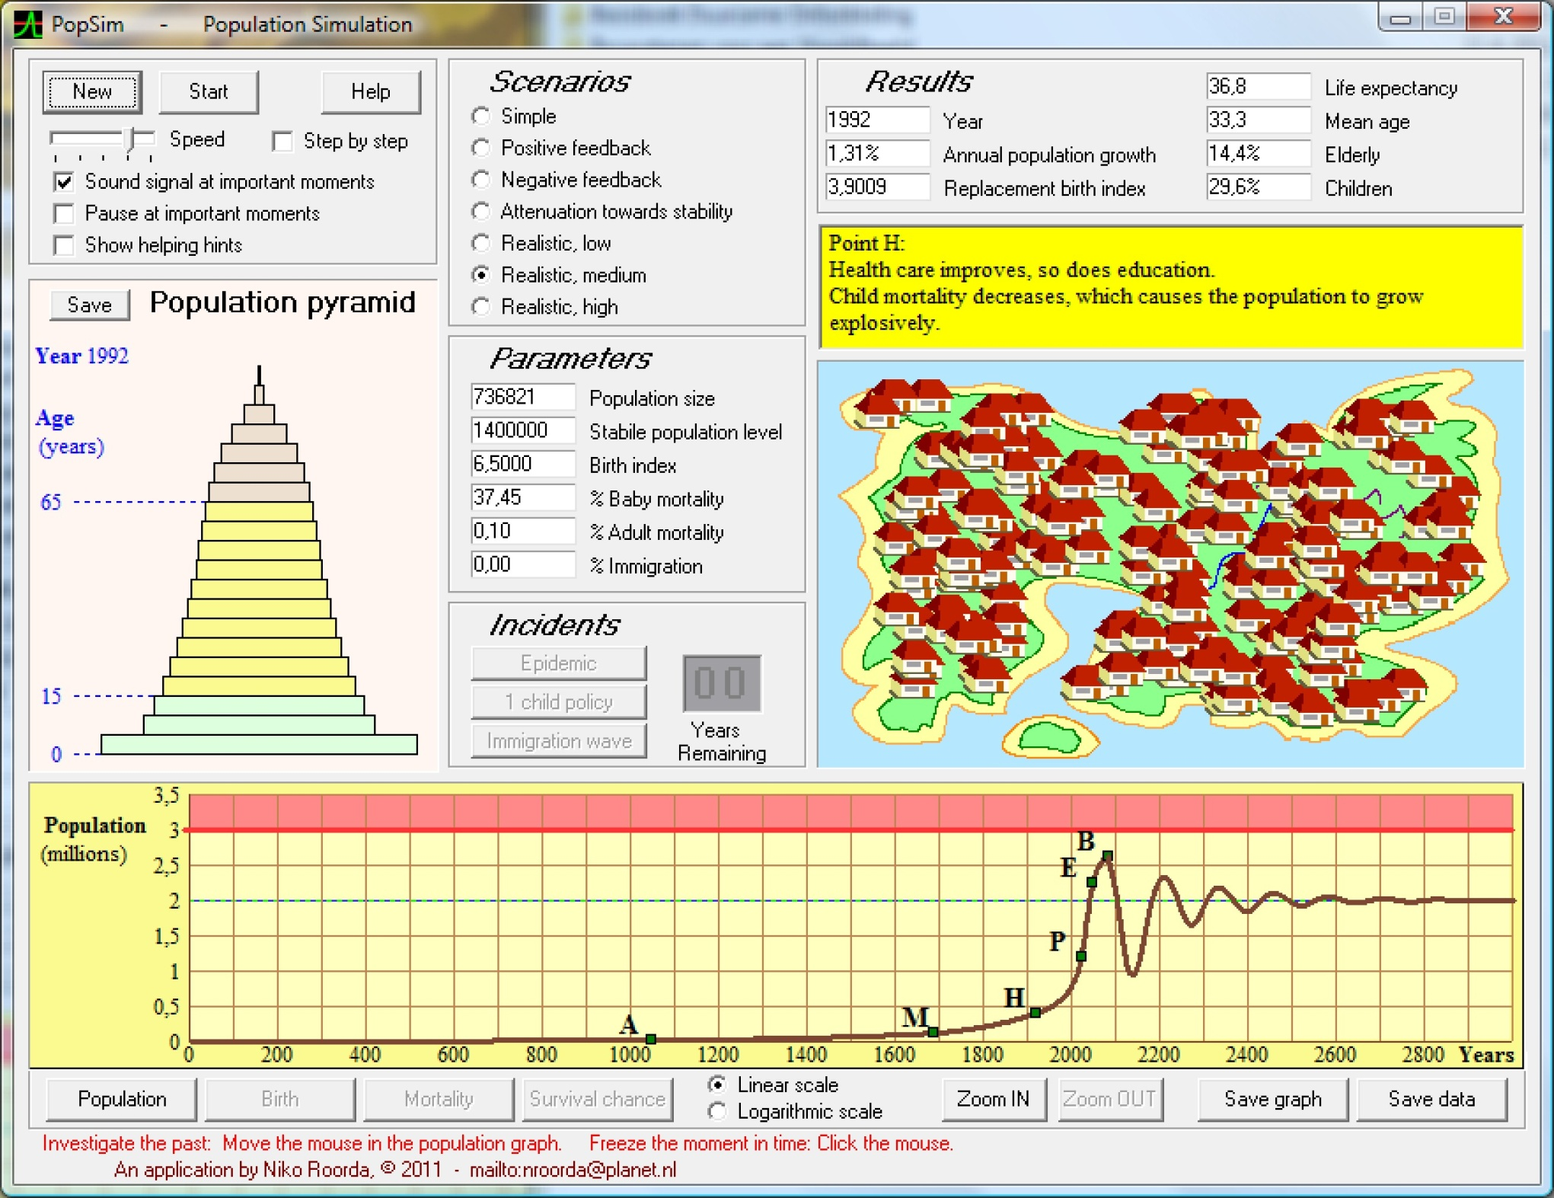
Serious game: “PopSim” (Population simulation)

Slide 31
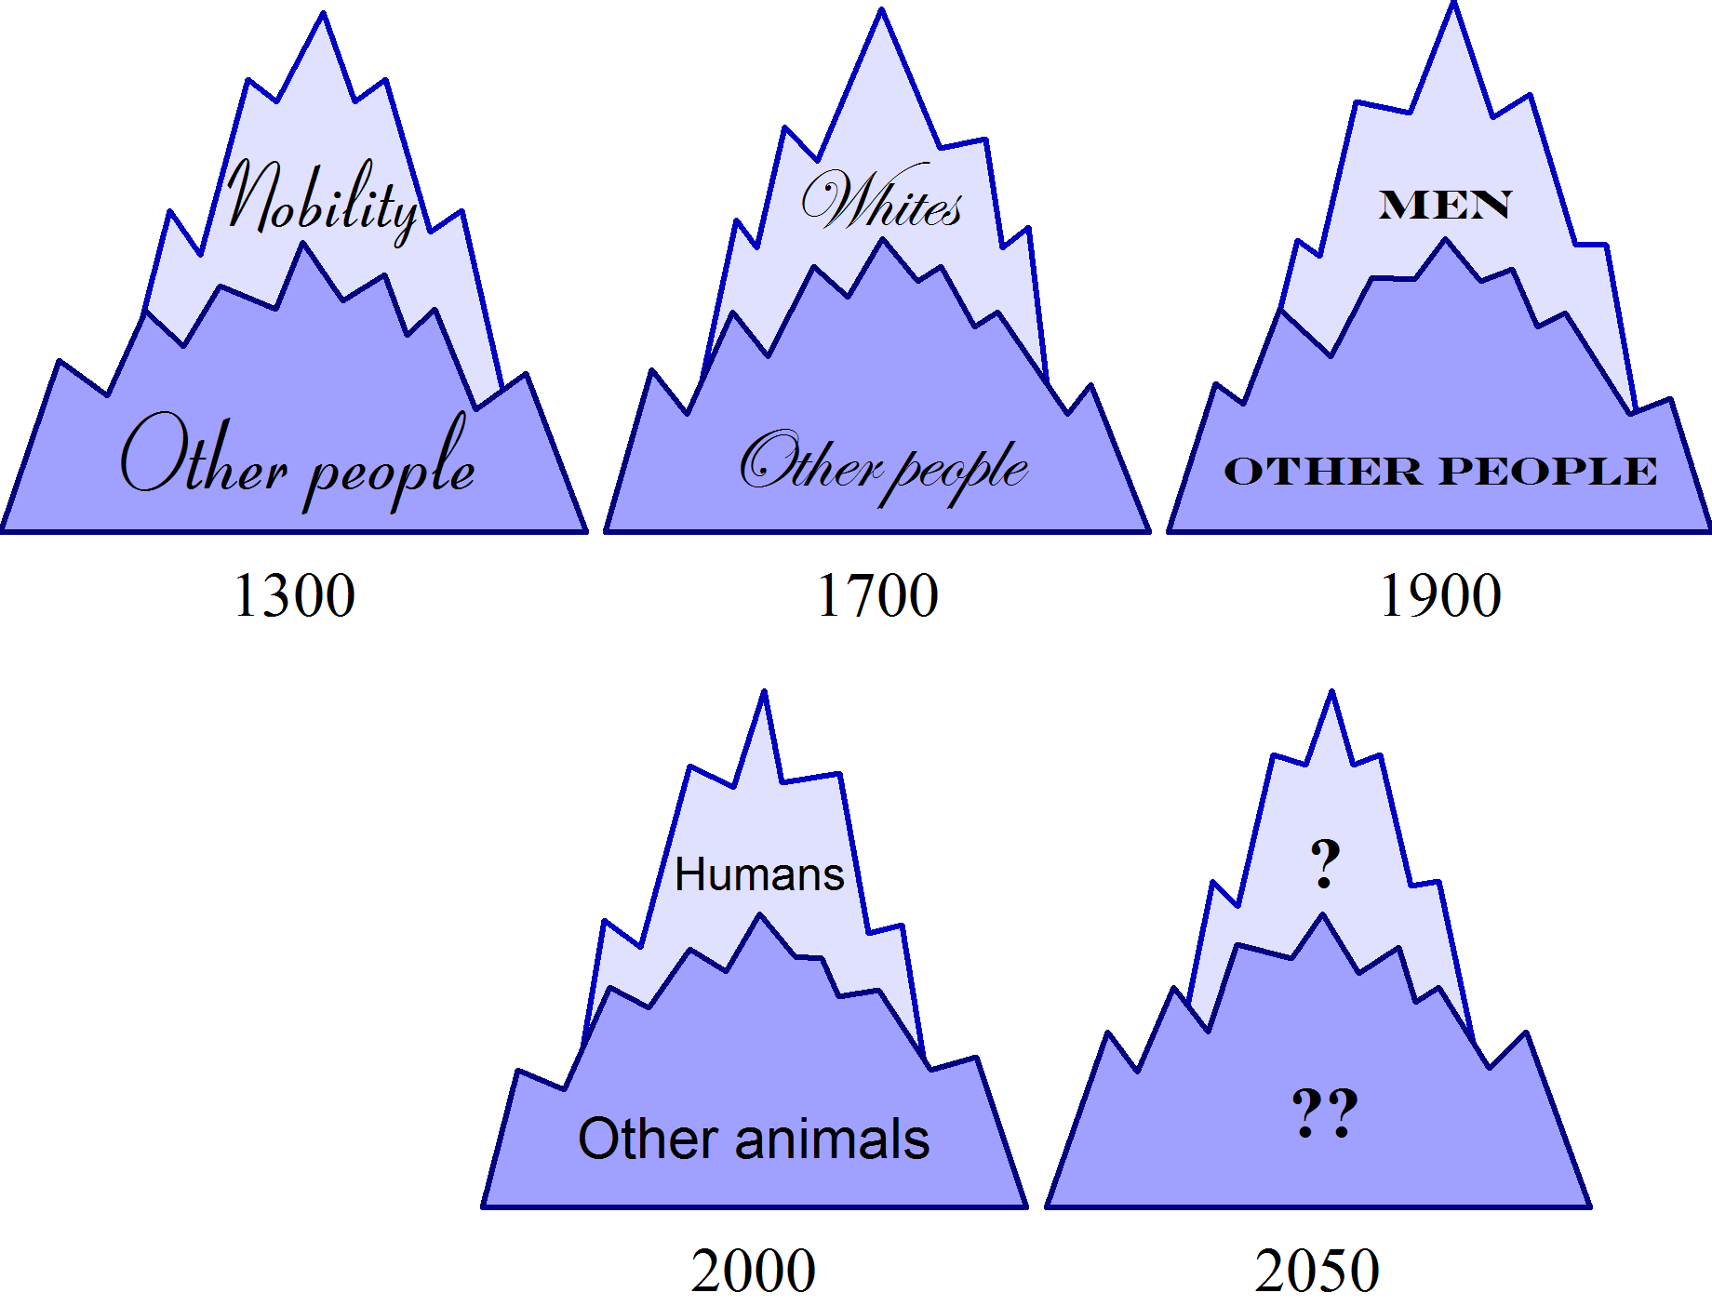
Discussion exercise: Shifting worldviews...

Slide 32
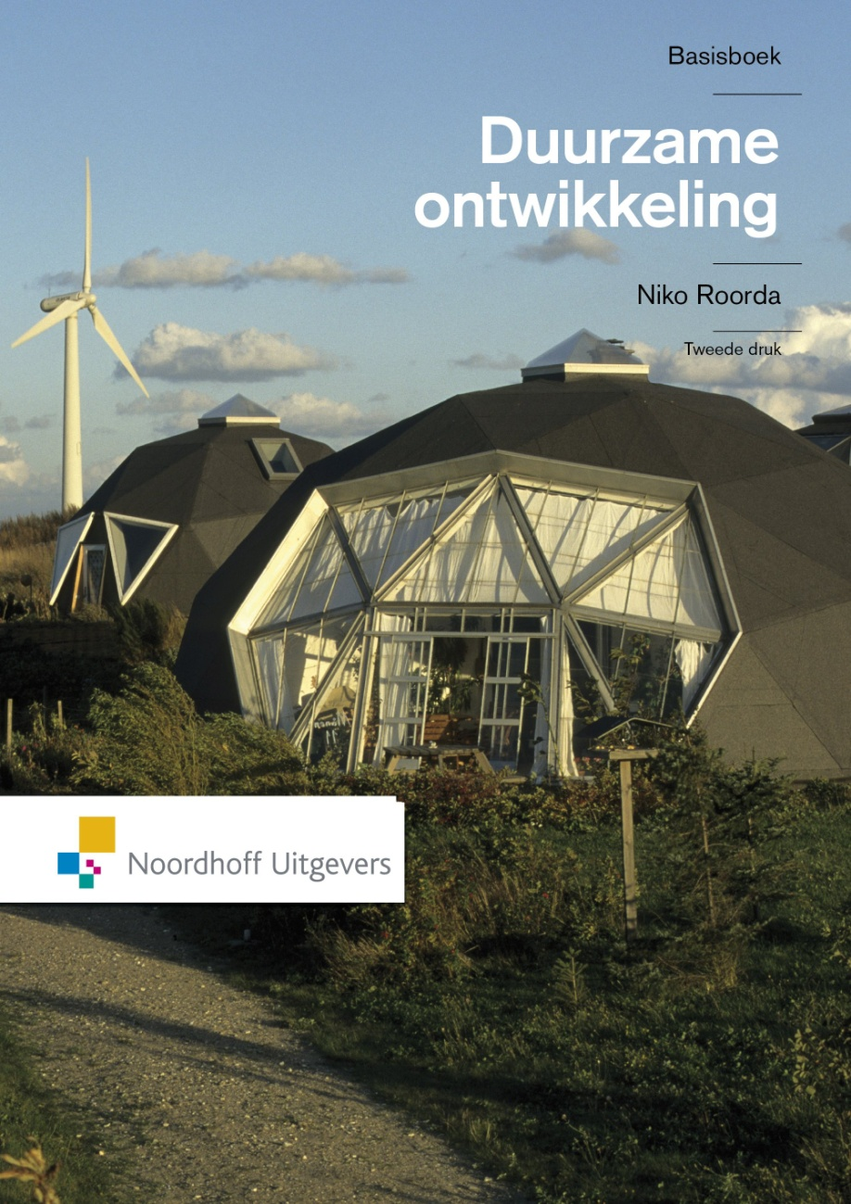
Book: ‘Fundamentals of Sustainable Development’
Dutch editions: 2005, 2011
English edition: February 2012
The website offers:
> 200 exercises
Circa 40 videoclips
Serious games (computer programmes)
Learning goals per chapter
Summary per chapter
Extra information per chapter
Explaining glossary
Spreadsheets, schemes, etc.
And only for educators (password protected):
Answers to exercises
Powerpoint per chapter

Slide 33
Inter- & transdisciplinary cooperation
Disciplinary focuses
Multidisciplinary relations
Methodologies
Basics: introduction to SD
Input: Mission, goals
Output: Effect on profession &society

Slide 34
Levels of change (according to Sterling)
 | Level 1: Accomodation | Level 2: Reformation | Level 3: Transformation (Transition)
Result | ‘Bolted on’ | Build-in | System redesign
Effect on education | Cosmetic change | Real change | ‘In the genes’
Continuity | Can easily be undone | Can still be undone | Anchored
Source: Dissertation Roorda (2010), table 2; derived from Sterling (2004) *
Levels of change (according to Sterling)
 | Level 1: Accomodation | Level 2: Reformation | Level 3: Transformation (Transition)
Result | ‘Bolted on’ | Build-in | System redesign
Effect on education | Cosmetic change | Real change | ‘In the genes’
Continuity | Can easily be undone | Can still be undone | Anchored
Source: Dissertation Roorda (2010), table 2; derived from Sterling (2004) *
Levels of change (according to Sterling)
 | Level 1: Accomodation | Level 2: Reformation | Level 3: Transformation (Transition)
Result | ‘Bolted on’ | Build-in | System redesign
Effect on education | Cosmetic change | Real change | ‘In the genes’
Continuity | Can easily be undone | Can still be undone | Anchored
Source: Dissertation Roorda (2010), table 2; derived from Sterling (2004) *
Levels of change (according to Sterling)
 | Level 1: Accomodation | Level 2: Reformation | Level 3: Transformation (Transition)
Result | ‘Bolted on’ | Build-in | System redesign
Effect on education | Cosmetic change | Real change | ‘In the genes’
Continuity | Can easily be undone | Can still be undone | Anchored
Source: Dissertation Roorda (2010), table 2; derived from Sterling (2004) *
System integration
is possible through small steps, ‘Sailing on the Winds of Change’!
* Sterling, Stephen (2004): “Higher Education, Sustainability and the Role of Systemic Learning.” In: Corcoran, P.B., A.E.J. Wals (eds.) (2004): “Higher Education and the challenge of sustainability”. Kluwer, Dordrecht.

Slide 35
Stage 1: Ad hoc activities
Organisation development (EFQM, AISHE): 5 stages
Stage 5: Society
and Ecosystem
Stage 2: Process
Stage 3: System
Stage 4: Chain

Slide 36
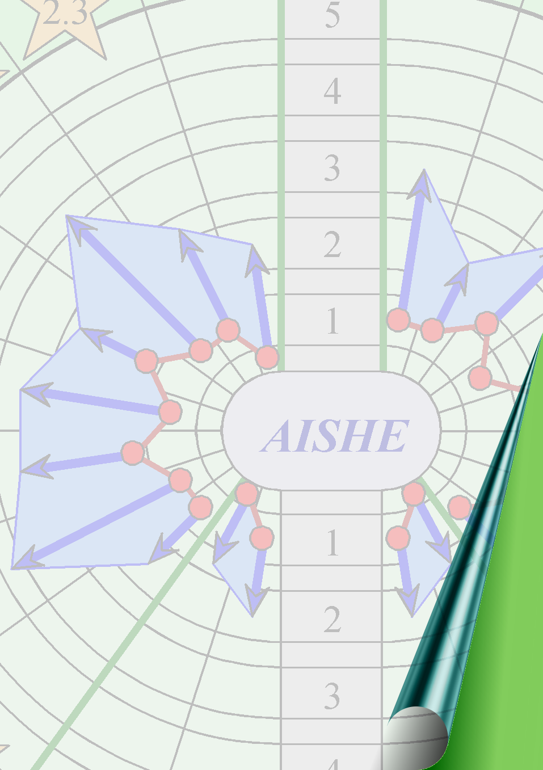
AISHE
Auditing Instrument for
Sustainability
in Higher Education

Slide 37
AISHE applied:
Netherlands
Belgium
Sweden (Swedish translation: ISBN 978-86135-17-1, 2008)
Germany
Austria
Spain
Ukrain
Bangladesh
Brazil
Interested universities:
Argentina, Colombia, Venezuela, Ecuador (training Buenos Aires, 2009)
Belarus
Canada
Portugal
Australia

Slide 38
AISHE 1 (2001)

Slide 40
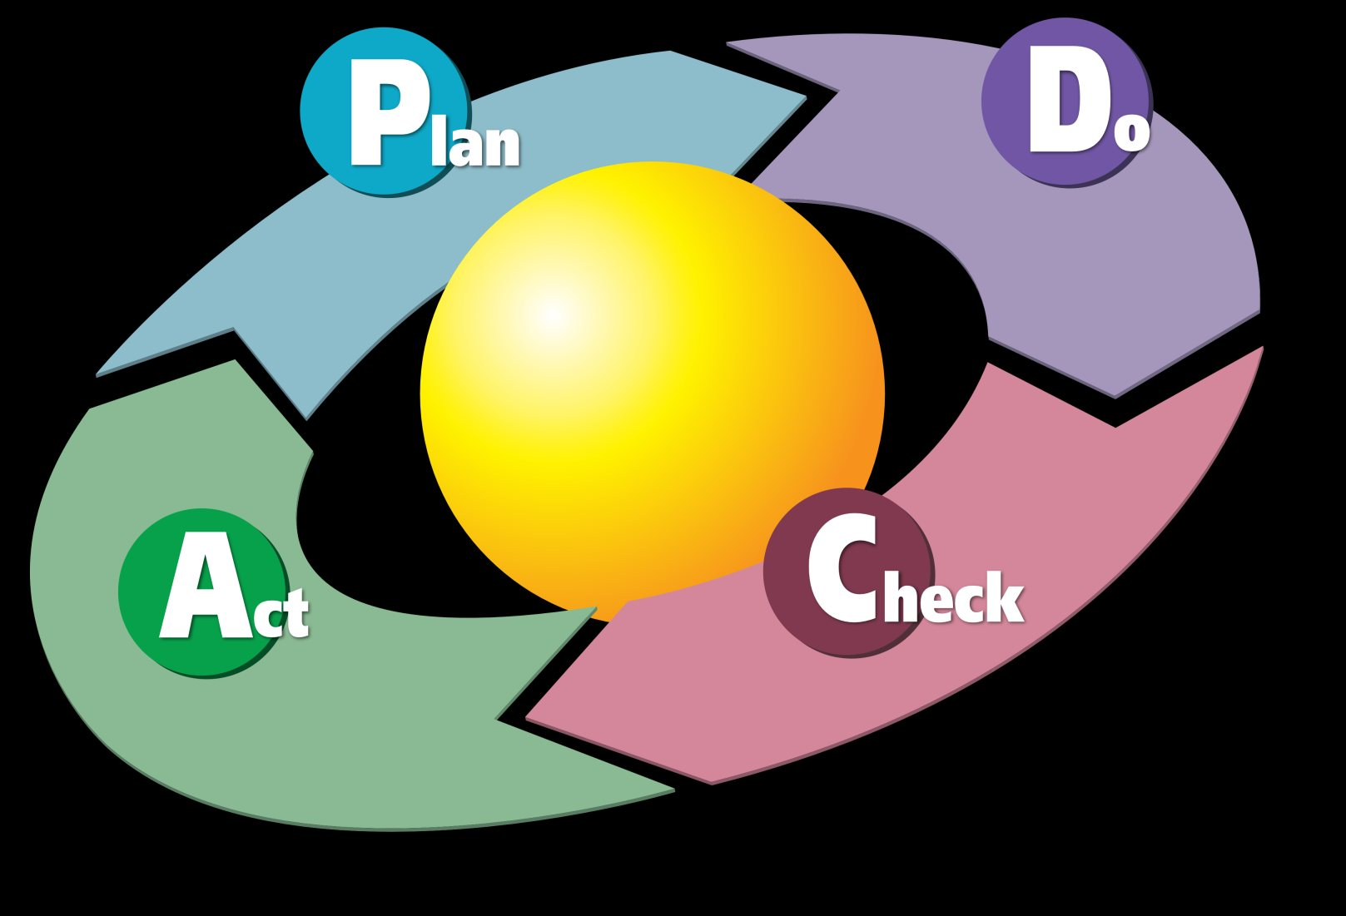
Deming Cycle of continuous improvement

Slide 43
E-1. Education Goals
The graduate profile determines the end goals of the education, i.e. the characterization of the professional who leaves the educational program and enters the professional field. Various terms are used for the graduate profile, e.g.: “educational program goals”; “professional profile”; ”academic qualifications”, “professional competencies”. etc.
Stage 1: Activity oriented | Stage 2: Process oriented | Stage 3: System oriented | Stage 4: Chain oriented | Stage 5: Society oriented
- The graduate profile contains some clearly recognizable aspects of SD. | - Within the own disciplinary context, the profile contains all or most relevant aspects of SD. | - The profile is explicitly based on the vision of the organization on SD. - Students are actively involved in the determination of the profile. | - The professional field is actively involved in the determination of the profile. | - Society is actively involved in the determination of the profile. Compared with comparable institutions the organization fulfils a leading role with respect to the determination of the profile.

Slide 44
The assessment process
Participation by ca. 15 people:
1 or more managers
Ca. 8 professors / lecturers / teachers
Ca. 5 students
1 or more non-teaching staff
Time use: less than 1 day:
Introduction by assessor …….. 45 min.
Individual scoring by AISHE participants …….. 45 min.
Consensus meeting …….. 3½ hours
Total …….. 5 hours

Slide 45
Part of an AISHE report:

Slide 46
So, what you get:
A coherent report
Real knowledge about what you have at present
(Not just on paper!)
Many ideas and proposals, enough to make a Policy Plan for SD for the coming year
Support, enthusiasm, passion with the staff & the students

Slide 47

DO
Policy
plan
… to a policy approach
PLAN
CHECK
ACT
Orientation
From separate starting steps …
Notes:
47

Slide 48
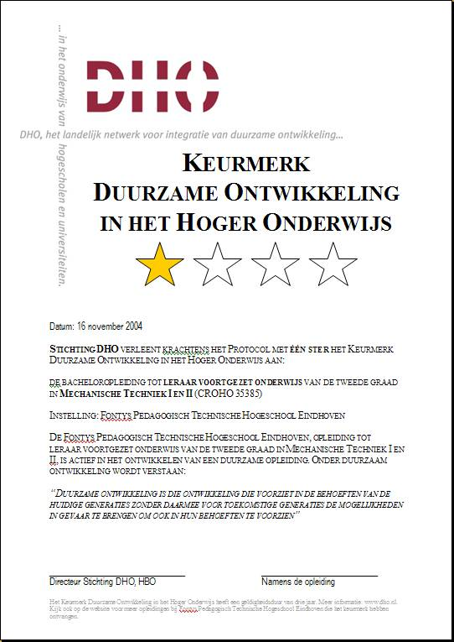
DO
Policy
plan
… to a policy approach
PLAN
CHECK
ACT
Certificate
Notes:
48

Slide 49

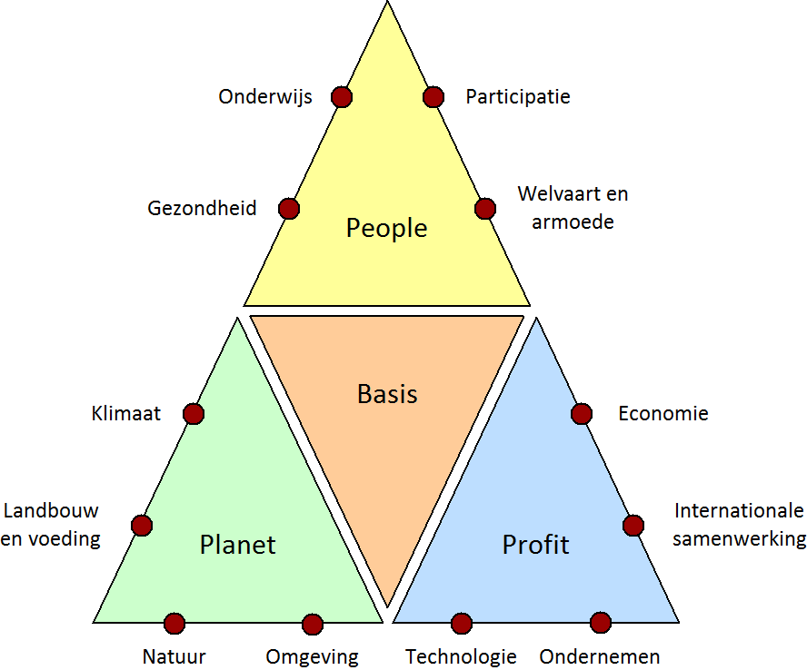
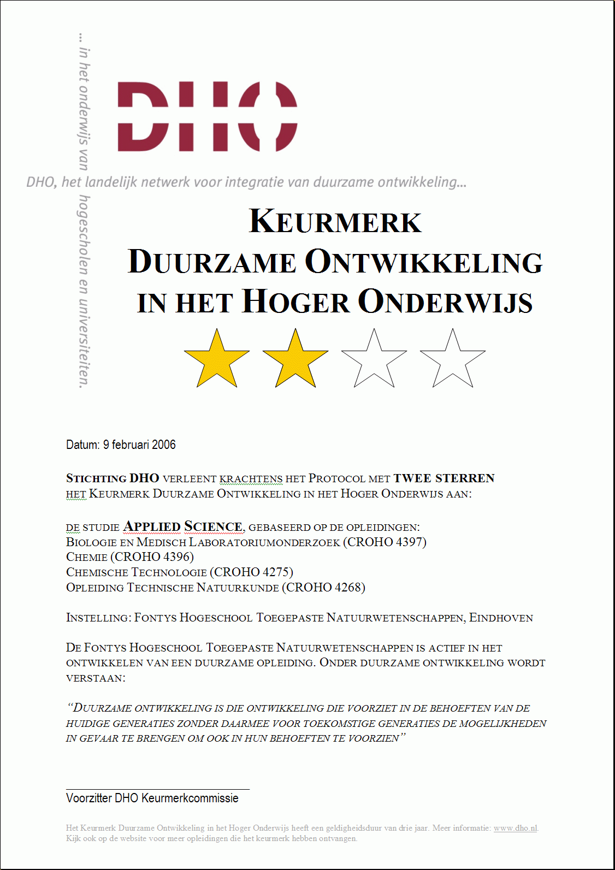
Instruments for organisational development
Checklist: Characteristics of Education for Sustainable Development
Principes | Kenmerken | Details
Verbondenheid, complexiteit | Systeemdenken | Verbinden van delen, subsystemen of aspectsystemen. Wisselen tussen analytische en holistische benadering; tussen klein en groot; en locaal met globaal.
 | Multi-, inter- of transdisciplinariteit | Verbinden van disciplines en stakeholders. Evenwicht m.b.t. Triple P; evenwicht m.b.t. disciplines.
 | Levenscyclus-benadering | verbinden van fases in de levenscyclus. Betreft levenscycli van mensen, producten, bedrijven, habitats, culturen, ontwerpen, paradigma’s, etc.
 | Intercultureel, internationaal | Verbinden van mensen, (sub)culturen, regio’s, landen. Openstaan voor waarden en perspectieven van anderen.
 | Toekomst-oriëntatie | Verbinden van verleden, heden en toekomst. Betreft zowel lange- en korte-termijn doelen, gebaseerd op visies van duurzame toekomstige ontwikkelingen.
Innovativiteit | Openstaan voor verandering | Soepelheid van geest; vermogen tot omgaan met onzekerheid.
 | Openstaan voor nieuwe oplossingen | Creativiteit, non-lineariteit, out of the box denken, aanvaarden van het onverwachte.
 | Functie- oriëntatie | Stimuleren van creatieve ideeën en ontwerpprocessen, uitzoomend vanuit bestaande producten of diensten naar onderliggende functies of behoeften, gericht op het vinden van alternatieve manieren om die te vervullen.
Actieleren, sociaal leren | Toepassing van kennis | Verkrijgen en toepassen van kennis, hetzij na elkaar, hetzij tegelijkertijd (‘learning by doing’). Gericht op vinden van toepasbare oplossingen voor reële problemen.
 | Multi-methoden | Bijv. just-in-time lessen, discussies, drama, spellen, etc.
 | Realistische situaties | Contextrijk leren, in gesimuleerde of werkelijk bestaande situaties.
 | Betrokkenheid | Persoonlijk betrokken, gericht duurzaamheidsdoelen.
 | Samenwerken | Teamwerk binnen studentengroepen; samenwerking met experts, professionals.
Reflexiviteit | Leren leren | Reflectie op het eigen leerproces, gericht op continue verbetering. Levenslang leren.
 | Verantwoordelijk-heid | Verantwoordelijkheid voor het eigen leerproces, en (tot op zekere hoogte) voor de leerdoelen. Ook: verantwoordelijkheid voor resultaten van professionele activiteiten (stakeholder benadering).
 | Waarde-gedreven | Bewust van de relevantie en de betrekkelijkheid van impliciete waarden en meningen
 | Kritisch denken | Kritische houding t.a.v. vragen, opdrachten, methoden, antwoorden, eigen functioneren
 | Robuustheid van informatie | Bewust van mate van zekerheid van kennis, gegevens, conclusies: subjectief, intersubjectief, objectief (opinies, theorieën, feiten)
Voornaamste bronnen: Agenda 21 (UNCED, 1992), Orr (1992), De Haan & Harenberg (1999), De Haan (2002),Sterling (2004), UNESCO (2004a, 2005), UNECE (2005), Martens (2006), Van Dam-Mieras (2007), Dyball, Brown & Keen (2007), Barth & Burandt (2008), Dieleman and Juárez-Nájera (2008).
RESFIA+D : Competences for SD
Competentie V: Verantwoordelijkh. Een duurzame professional draagt verantwoordelijkheid voor het eigen werk. | Competentie E: Emot. intelligentie Een duurzame professional leeft zich in in waarden en gevoelens van anderen.
Competentie S: Systeemgerichtheid Een duurzame professional denkt en werkt vanuit een systeemvisie. | Competentie T: Toekomstgerichtheid Een duurzame professional denkt en werkt vanuit een toekomstperspectief.
Competentie I: persoonlijke Inzet Een duurzame professional zet zich persoonlijk in voor duurzame ontwikkeling. | Competentie A: Actievaardigheid Een duurzame professional treedt besluitvaardig en handelingsbekwaam op.
Plus D: Disciplinaire competenties voor duurzame ontwikkeling
DO
RESFIA+D
Basic book
Dissertation
Checklist
Tree model
AISHE
Certificate
Curriculum Scan

Slide 50
Characteristics of an (ideal) AISHE assessor
Expert on Sustainable Development
  Broad, multidisc. knowledge about main aspects of SD
  Expertise on relevant SD processes
  Insight in consequences of SD for education
Expert on Education
  Experienced teacher
  Experienced education developer
  Experienced education manager
Experienced chair person
  Experienced discussion leader
  Capacity for critical reflection
  Respect, neutrality, open-mindedness
Experienced assessor
  Knowledge of Quality Management
  Knowledge & experience with AISHE
  Experience with Reporting

Slide 51
Proposal:
Later, this week:
a workshop to get the feel of it
Next time, in November (Lisbon):
a training of 1 whole day, for those who want to apply AISHE in their own university
= First step towards AISHE Assessor Certificate
Next: join in setting up the
International Certificate on ESD
(Education for Sustainable Development)

